Slide 1
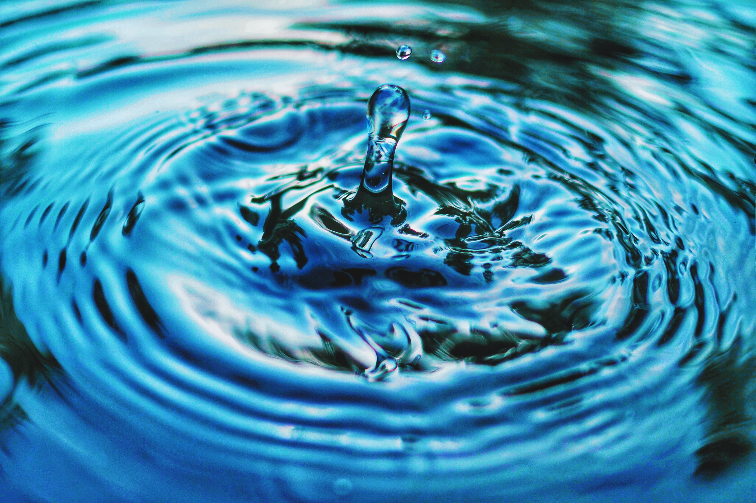
Drink from the well: Good News!
Christmas and Epiphany
The outline for this reflection can be found in the Notes section of the Power Point.
Notes:
These reflective resources, entitled ‘Drink from the Well’, are designed to be used flexibly and to be adapted for your context; they can be used as the basis for an assembly, for collective worship or for a time of reflection to support personal wellbeing and SMSC across the curriculum. This set of resources will be added to on a regular basis and to begin with, they will focus on the values which underpin the work of Christian Aid. We will seek to use a wide range of materials as a starting point for reflection and to introduce pupils to different voices from across the world.
The theme of this ‘Drink from the well’ is good news and it can be used during the Advent, Christmas and Epiphany season – a time when Christians reflect on the Christmas Nativity story and the belief that the birth of Jesus brings good news and hope to the world. This reflection focusses on the sharing of good news and includes examples from the work of Christian Aid but also allows space to share your own community good news stories.
This resource provides opportunities for learning, reflection and action and is divided into three sections:
Gather round the well – think, talk, and learn together
Drink deeply from the well – reflect on your learning
Go refreshed – respond and act

Slide 2

Gather round the well – think, talk, and learn together
Notes:
Welcome pupils to your assembly/collective worship but, as you do so, have a pupil/teacher primed to interrupt you to bring you an important message written on a folded piece of paper. They ring a bell, bang a drum or blow a whistle to get everyone’s attention. The message-bringer stresses that the message is very important and needs to be shared with everyone.
Photo credit: Unsplash/Pascal Meier

Slide 3

Notes:
Read the message and share:
Hello Everyone
Good news challenge!
Could your class become good news detectives this week? Could you listen out for good news stories in our school community, local community, from around the world and in the news? Could you give a shout out to someone who has shown courage, kindness or helped to change something for the better?
Explain that during the week you are going to share some good news stories during collective worship/assembly and that there will be opportunities in class time to share stories of good news. At the end of the week, you will share in a ‘Good News Celebration’ to share some of the good news you have talked about in your classes. Are you up to the challenge?

Slide 4


Sending a message
Notes:
I wonder, how else could this message have been shared with us? (E.g. by voice, text or email.) Our messenger used the sound of a bell/whistle/drum to catch our attention. What other ways are there of drawing our attention to important messages? Include trumpets, drums, bells, town-criers…
Did you notice how the message we received began? It started with a greeting. I wonder, can you think of ways you might greet a friend or family member? On ordinary days? What about on special days?

Slide 5

Notes:
When do we send special and joyful messages to one another? Are there particular times of year when you might send a special message to a friend or family member? (E.g. a birthday, religious festival, wedding.)
When might we share good news? (E.g. the birth of a new baby, when we start something new and exciting.)
Sharing good news is something we can do all year round but I wonder why this time of year might be a time when many people like to greet one another and share joyful news?

Slide 6

Notes:
In the UK, and in many places across the world, the Christmas season is a time when there is a pause from work and when family and friends spend time together, exchange gifts and kind messages.
Christians across the world celebrate the festival of Christmas and Epiphany during December and January. They focus on the Christmas nativity story – a story which includes special messages and the sharing of good news. Before Christmas there is a time of waiting, preparation and anticipation called Advent; you might have or have heard of an advent calendar, candle or wreath – all ways to count down to Christmas day and anticipate a time of celebration and sharing of good news. All religions have special days and dates – you could ask the class if they can name any festivals that are important in other faiths, e.g. Eid for Muslims and Hanukkah for Jewish people. Each faith's religious festivals have special meaning and significance for the people who follow that faith.

Slide 7
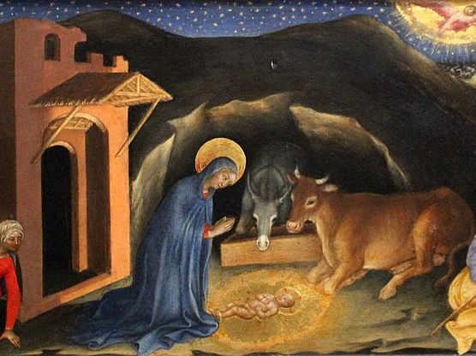
Notes:
I wonder, what can you remember about the Christian Nativity story? Why might the Christian story about the birth Jesus be about good news? Who are the messengers in the story and the good news bringers?
Let’s look at some paintings and spend some time talking in 2s and 3s.
Look closely at each painting - what do you notice? What do you like/dislike about each picture? What clues are there in the pictures that they are about a story of hope & joy - things that we might call good news.
Talk about how have the artists shown messengers in their picture? How have they shown that this is a picture about an important event? How have they shown that the birth of Jesus is a message of hope and good news? Think about their use of colour, light, shade, and symbols.
If you are using this material after Christmas during Epiphany you may want to mainly focus on the image on slide 11 and the part of the Christmas narrative which tells the story of the visit of the Magi [ see Matthew 2:1-12] . Discuss the significance of the star and the gifts within this part of the nativity story.
Photo credit: Gentile da Fabriano, Public domain, via Wikimedia Commons

Slide 8
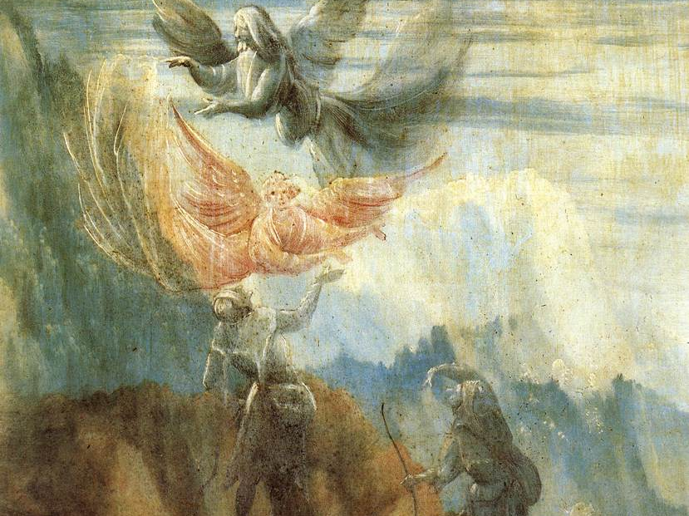
Notes:
Photo credit: Matthias Grünewald, Public domain, via Wikimedia Commons

Slide 9
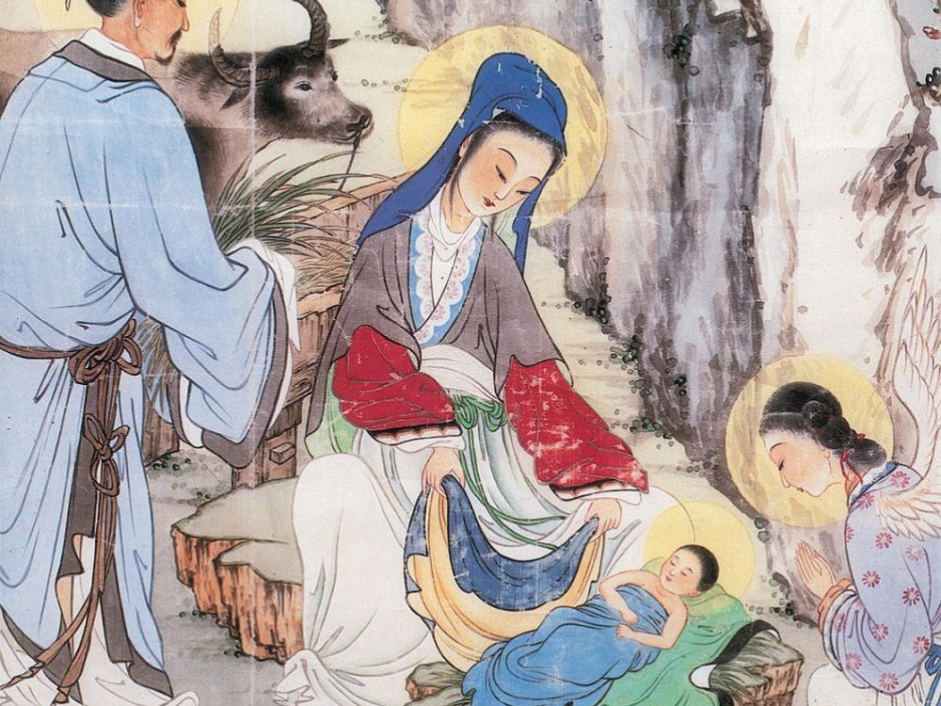
Notes:
Photo credit: Unknown author, CC BY-SA 2.5 <https://creativecommons.org/licenses/by-sa/2.5>, via Wikimedia Commons

Slide 10
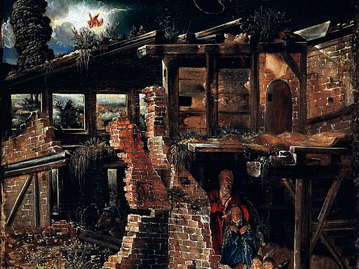
Notes:
Now let’s listen to a version of the Christmas nativity story and try to spot all the ways in which good news is shared.
Read or watch a child friendly version of the Christian Nativity story.
Talk about the story and what you noticed. What did the angels say about Jesus? Why would he be good news?
The angels' message to the shepherds promised that Jesus would bring joy to the earth, that he would be a rescuer and a king who lives forever. How did they react when they heard this message?
Photo credit: Albrecht Altdorfer, Public domain, via Wikimedia Commons

Slide 11
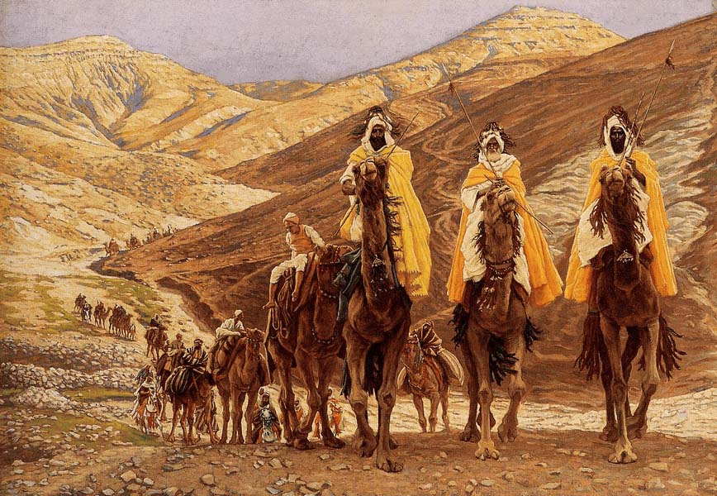
Notes:
James Tissot, Public domain, via Wikimedia Commons
This image can be used as a focus if you are using this material in the period after Christmas [season of Epiphany] when the story of the visit of the Magi is celebrated.

Slide 12
A child will be born to us…
He will be called….
Wonderful Adviser
Mighty God
Prince Who Brings Peace
Father Who Lives Forever
Notes:
Christians believe that the birth of Jesus had been promised for a long time and that he would be a special ruler and rescuer who would show people how much God loved them and how they could love God and one another – how they could be at peace with God and with one another.
These words, spoken many years before the birth of Jesus, describe the kind of special ruler the people expected and the kind of kingdom that he would create – a place where everyone can flourish and be treated with justice. These words are often read by Christians at Christmas time as they remember the birth of Jesus:
A child will be born to us.
A son will be given to us.
He will rule over us.
And he will be called
Wonderful Adviser and Mighty God.
He will also be called Father Who Lives Forever
and Prince Who Brings Peace.
⁷ There will be no limit to how great his authority is.
The peace he brings will never end.
He will rule on David’s throne
and over his kingdom.
He will make the kingdom strong and secure.
His rule will be based on what is fair and right.
It will last forever.
The Lord’s great love will make sure that happens.
He rules over all.
Isaiah 9 NIRV

Slide 13
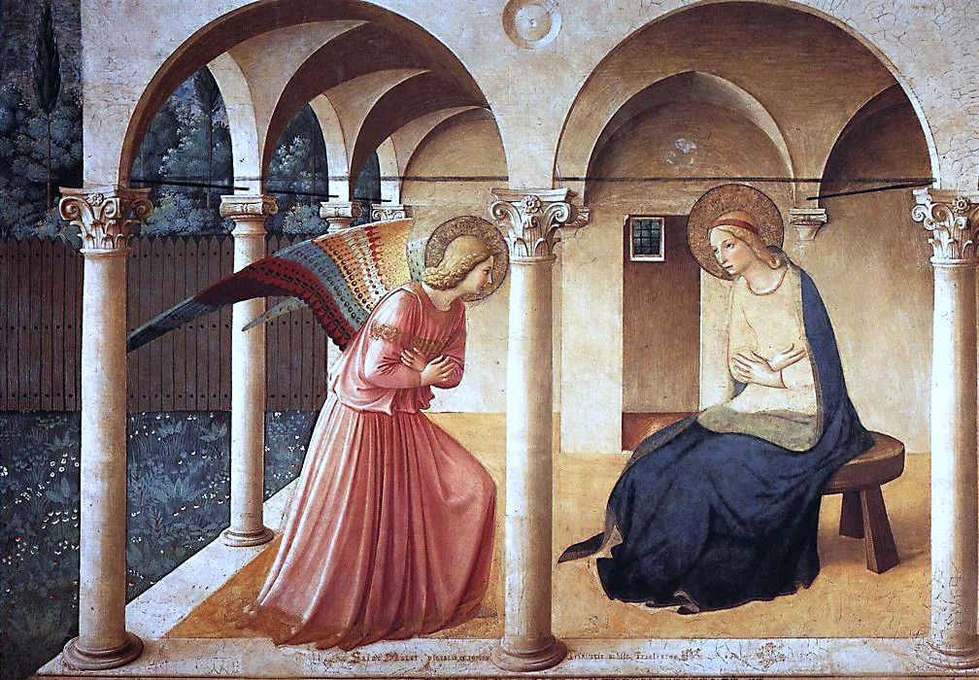
Notes:
The Bible says Mary didn’t really understand the angel message and the things that happened when Jesus was born but that she quietly thought about the things that had happened and took notice of other signs of good news as Jesus grew up and became an adult.
If time allows and you are using this material over several days or in class based collective worship, you could explore some of the ways in which Jesus was believed to be good news by looking at stories from his adult life – e.g. stories of healing; miracles; teaching; how he described himself and his work [Luke 4:16-21]
When Christians celebrate Christmas and Epiphany, they remember the promise that Jesus would bring good news, peace and justice to the earth and that as his followers they too should try to be good news in the world today by the way they live and the choices they make. That they should try to be people who bring light, joy, peace and hope to the world.
Photo credit: Fra Angelico, CC BY 2.0 <https://creativecommons.org/licenses/by/2.0>, via Wikimedia Commons

Slide 14
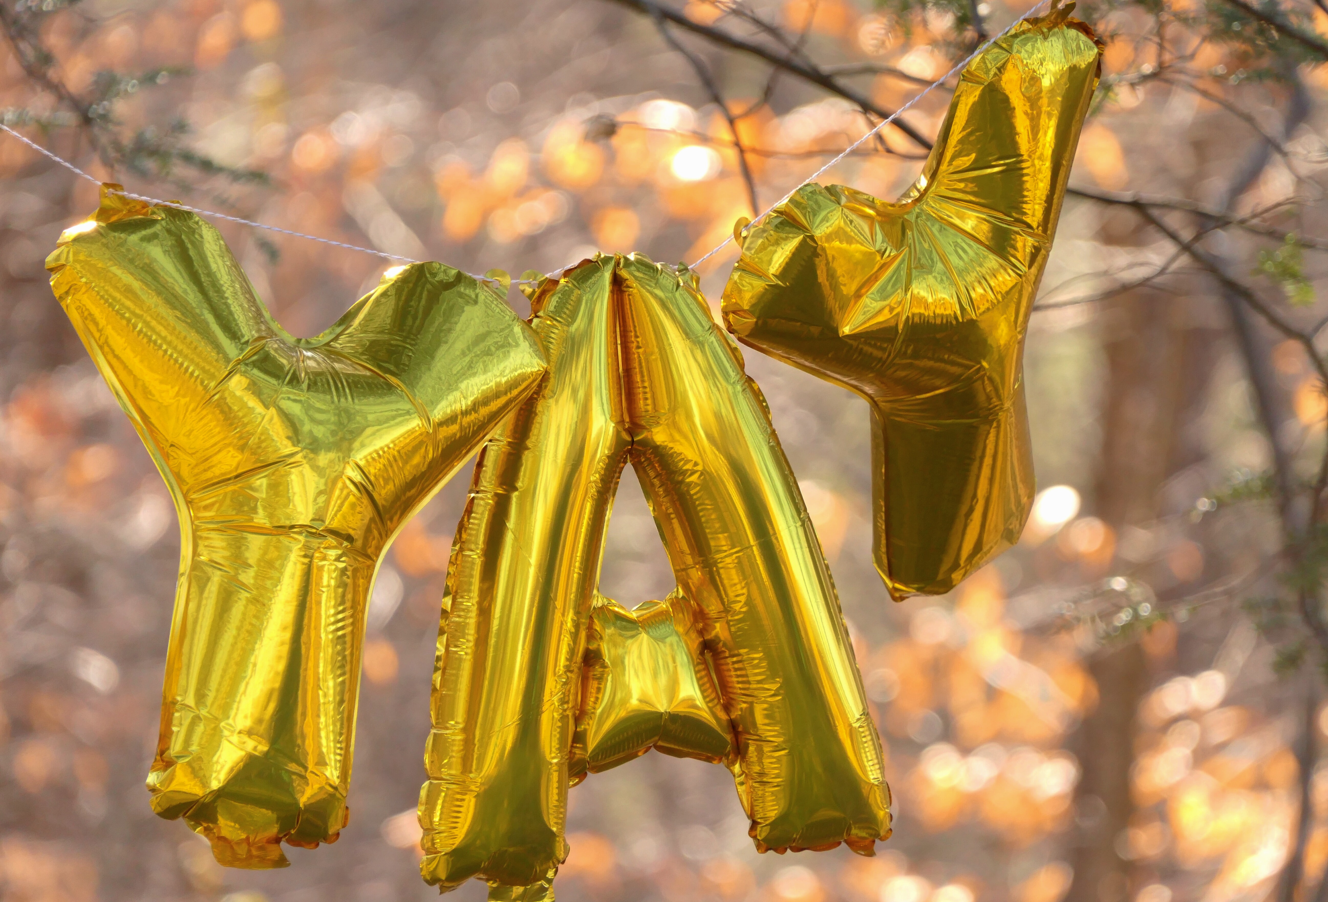
Good news stories…
Notes:
Good news actions such as living in peace with one another, showing love and kindness, making choices that are fair and just are values which are shared by many people – those of all faiths and none.
Can you think of any examples of good news stories which show people acting in this way? Allow time for discussion and then use one of the following examples. If you want to spend more time with this theme you could share all of the stories below over a number of days.
Photo by Patti Black on Unsplash

Slide 15

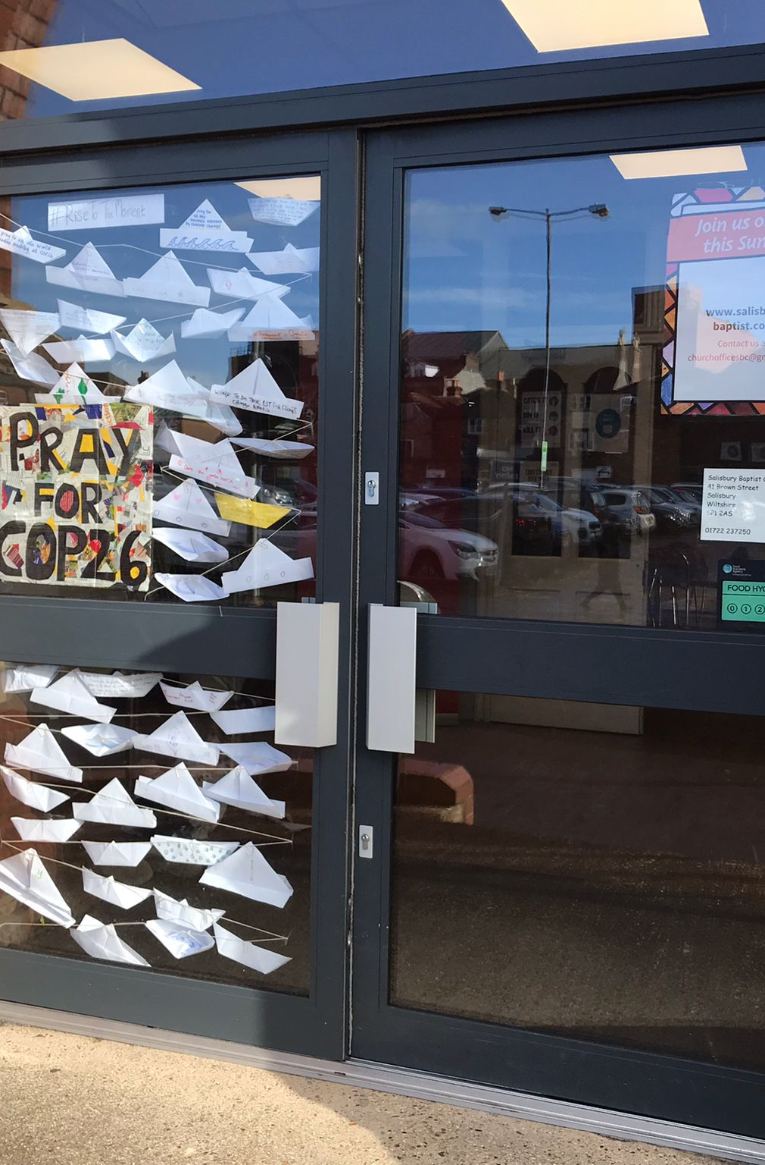
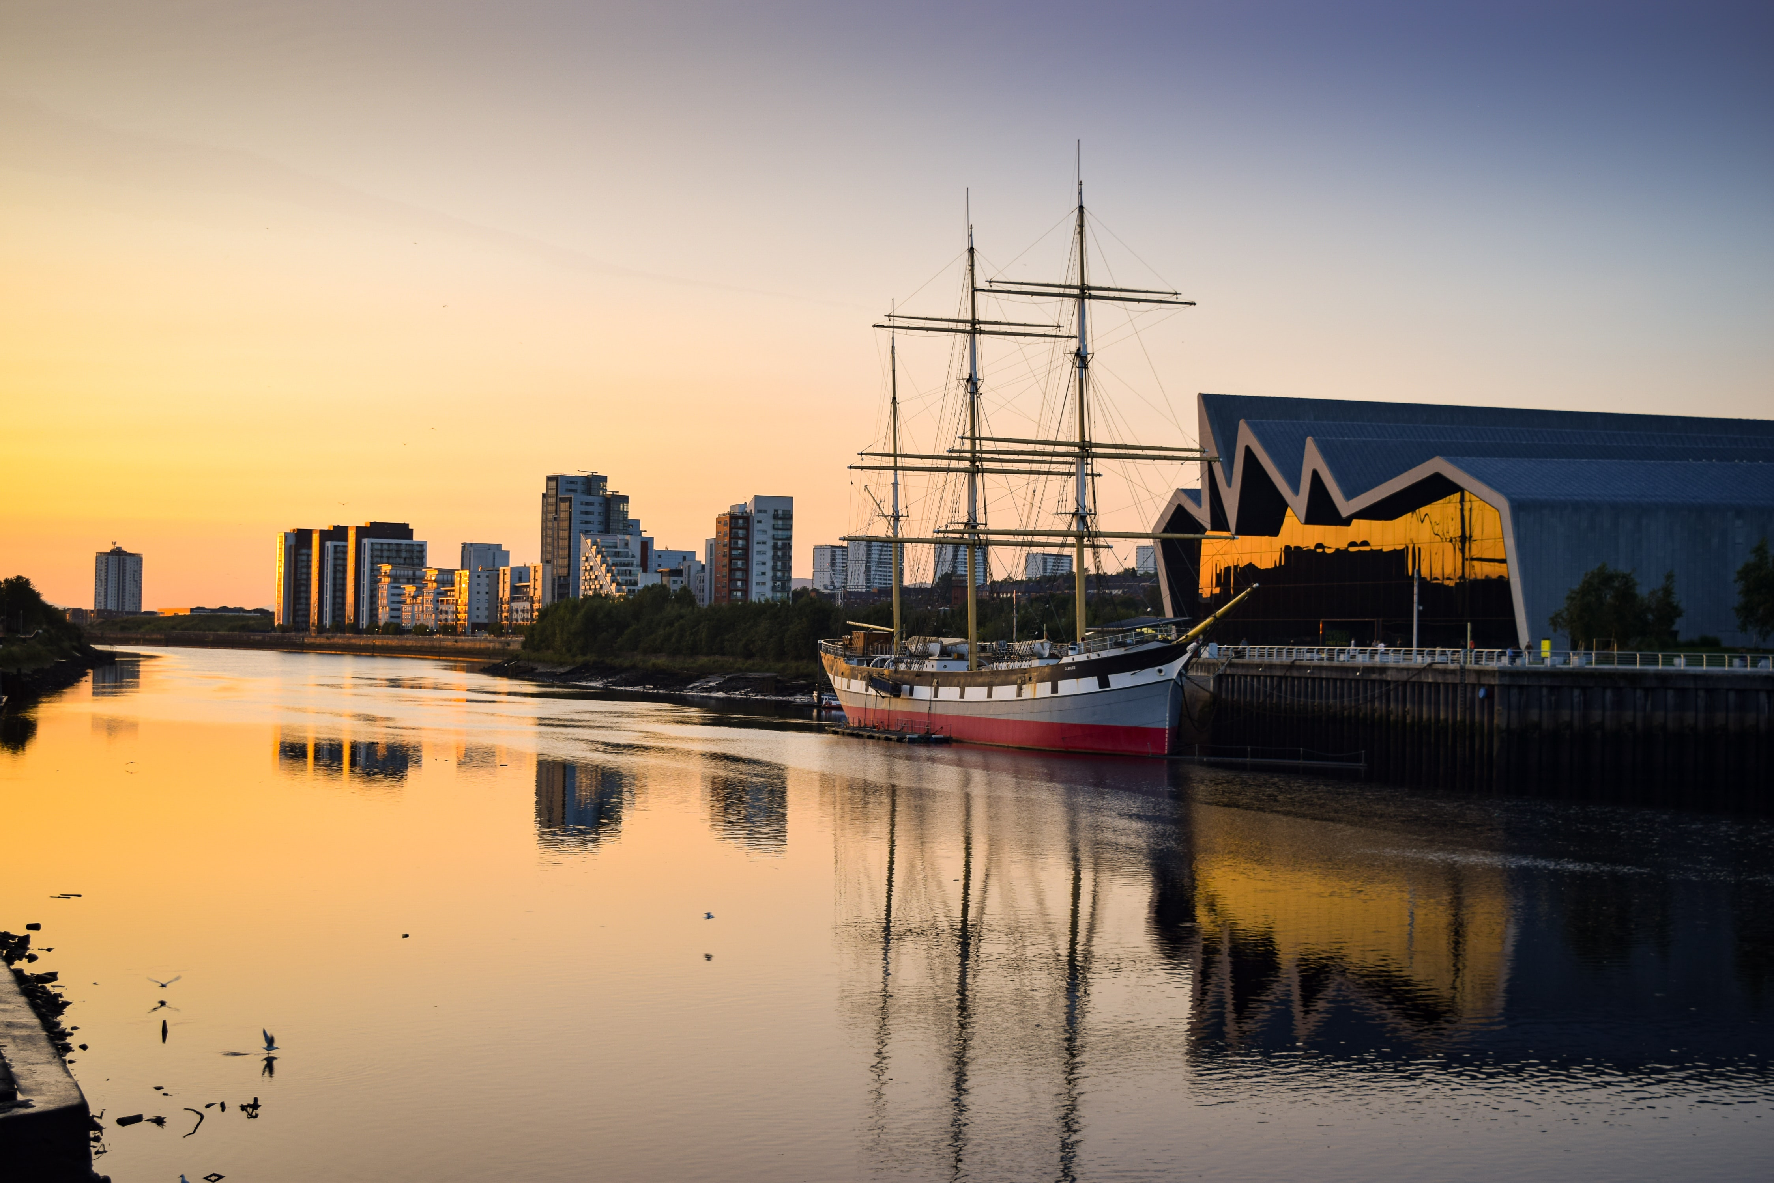
YCCN – Cornwall to Glasgow and COP 26
Notes:
Example 1: Young activists take action for climate justice and share a message of hope for the future
In 2021 a group of young Christian adults [Young Christian Climate Network] decided to take a message about the importance of climate justice to the world leaders gathering at COP 26 in Glasgow. However, they didn’t just take a train to Glasgow – instead they walked in a relay from Cornwall [after the G7 summit in June] to Glasgow [in November]. As they walked they gathered messages from members of the public to give to leaders and they encouraged church communities to pray and act for climate justice. They carried a large model boat with them as a symbol of the hope that leaders would use 2021 to help us all set sail towards a more just and fair future for everyone living on earth. By taking this action the YCCN hoped to be bringers of good news and hope through helping people understand the importance of climate justice and by sharing this message with world leaders. They hoped their actions would help build a fairer world and encourage people to look after the natural world and one another.
Photo by Annie Spratt on Unsplash
Photo by Fredrika Carlsson on Unsplash
Photo credit: Prayer boats by Derek Holloway

Slide 16
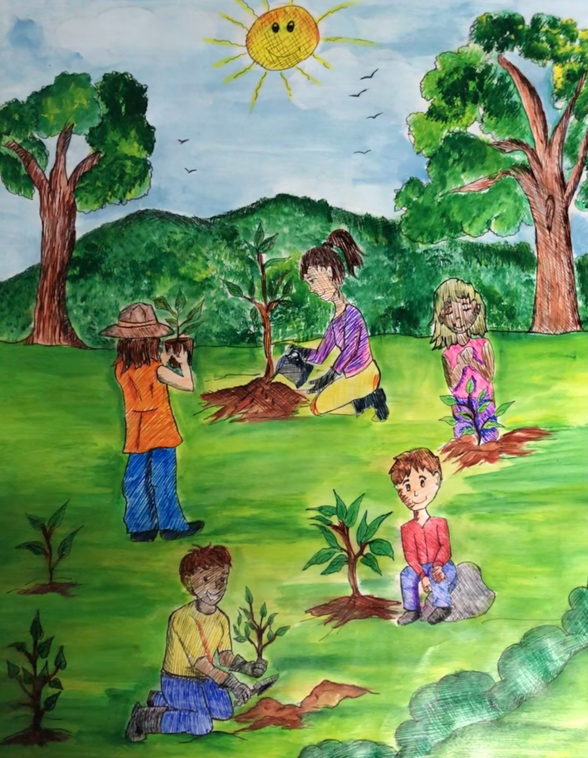
Letters for Creation
Notes:
Example 2: Young climate activists share a message about climate justice through art
As part of the Letters for Creation project young people in Panama created pieces of art on the theme of climate justice. The pupils reflected on how climate change is affecting their community and shared creative visions of hope for a better sustainable future. This image presents an image of hope for the future . Which part of the painting do you like best? What would you include if you created a painting/picture on this theme?
Children and young people from across the world are contributing to this arts-based project and sharing their messages about climate justice alongside their hopes for the future.
More information can be found here: https://www.christianaid.org.uk/get-involved/schools/letters-creation

Slide 17
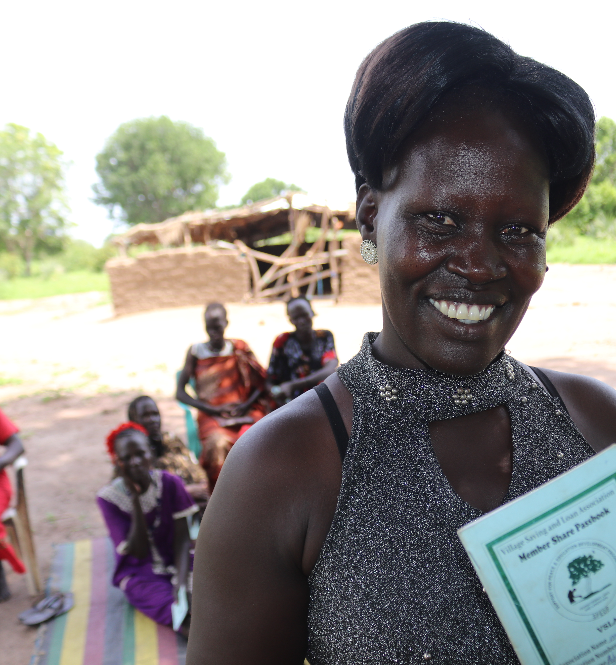
Taking on a new business opportunity
The success of a community savings project
Notes:
Example 3: Abuk Ayat Ajing
Across the world climate change is having an impact on people’s living conditions and livelihoods – mainly due to unpredictable weather patterns. It is often the people and countries which have contributed the least towards climate change who are now experiencing the worst affects of the changing climate – this is the issue which is at the centre of climate justice.
Abuk Ayat Ajing lives in South Sudan . Like many places, South Sudan is affected by the impact of climate change so that communities and individuals are having to find ways to adapt to the challenges which this brings. Unpredictable weather patterns such as floods or drought disrupt lives often causing pollution to water supplies, destroying both crops and livelihoods.
Abuk Ayat Ajing and other members of her community have worked with an organisation called ‘Support for Peace and Education Development Program’ (SPEDP), one of Christian Aid’s local partners in South Sudan, who helped to set up a community savings project [sometimes called a village savings and loans scheme]. This scheme involves members contributing funds into a saving scheme so there is then a source of money when someone in the group needs it.
Having run a successful restaurant business in the past, Abuk realised that the opportunity to be a part of this savings plan provided an ideal opportunity to set up a new business. As a bore hole had also recently been installed in the village to provide clean drinking water, Abuk decided to set up a tea shop. The money provided by the saving scheme enabled Abuk to buy chairs, kettles and teapots – all needed for setting up her new business.
When women like Abuk can earn their own money, they are better prepared to withstand climate shocks: from floods to droughts to natural disasters and can also save money towards school fees for their children and buy essential items such as food, medicines and clothes for their families.
Photo credit: Christian Aid/Silvano Yokwe

Slide 18
Drink deeply from the well – reflect on your learning
‘The light shines in the darkness, and the darkness can never extinguish it’
John 1:5 The Bible
Notes:
Play some quiet music and invite pupils to think about the following questions:
What would be good news for the world today?
Can you think of examples of good news in our school/local community
Personal reflective question: do I have opportunities, in small ways, to be a bringer of good news/hope in my family/community?
Community questions: how could we, as a school community, be or share stories of good news?
We can all be bringers of joy, hope and peace in the world:
I wonder, what does it mean to be a peacemaker?
How could we create a celebration of good news from our class, our school, our community, our country, our world?
Photo credit: Unsplash/Pascal Meier

Slide 19
Go refreshed – respond and act
“Darkness cannot drive out darkness: only light can do that. Hate cannot drive out hate: only love can do that.”
Martin Luther King Jr.
Notes:
Some possible response actions:
Think about how you could create a celebration of good news as a school
Doves of peace activity – use a dove template to create a display of doves to hang in a communal area in the school. Ask pupils to write prayers or messages of hope for the world on each dove.
Tree planting – could you plant a tree in your school grounds or in a community space as a sign of hope for a more sustainable future. If this isn’t possible, could pupils create small gardens in pots to be displayed around the school grounds.
Letters for Creation – could your pupils create ‘letters for creation’ and contribute to the Letters for Creation project? For lesson plans, resources and ideas go to the Christian Aid Schools webpage
Could your school join the ‘Let’s go zero’ campaign?
Photo credit: Unsplash/Pascal Meier

