Slide 1
Some reasons for hope
Sometimes when there is a lot bad news it can be really helpful to find the good news story that can be a shining light of hope in the darkness of the bad news.

Slide 2
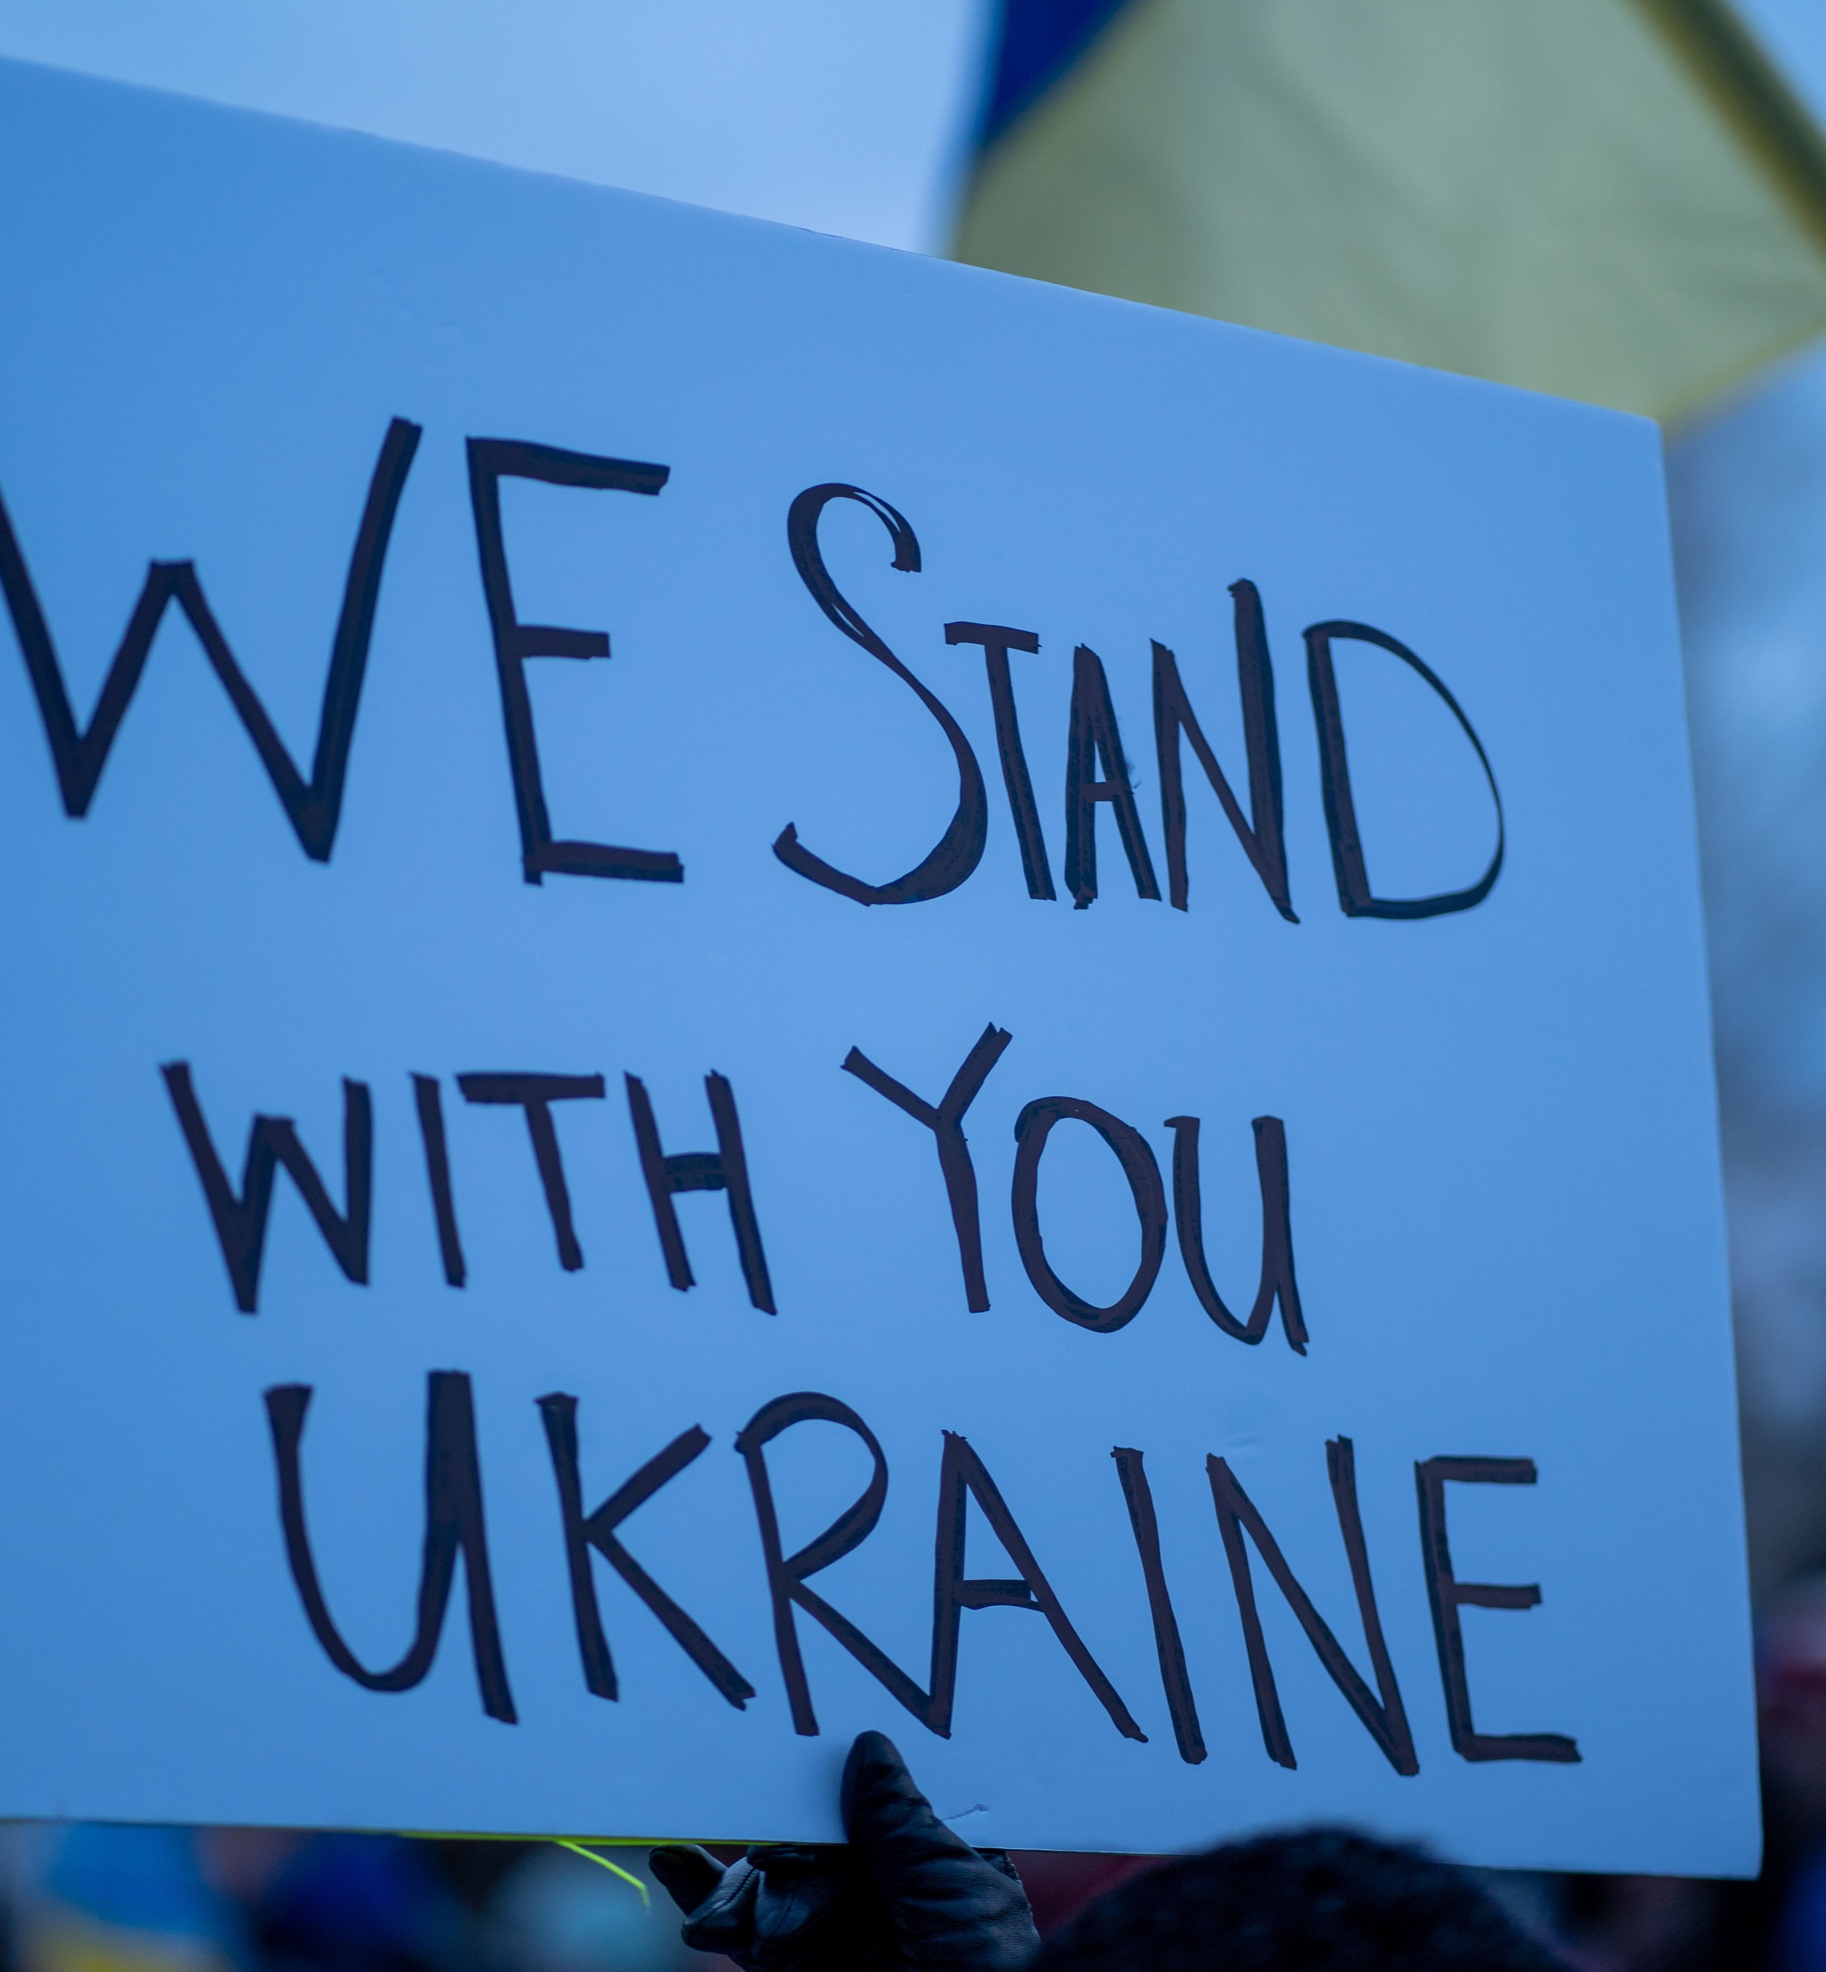
People all around the world are standing together for peace.
All around the world ordinary people are coming together to call for peace.
Many ordinary Russian people have protested, at great risk to themselves, to stop the War in Ukraine.
Instead of being divided by war people in their thousands are uniting in the name of peace.
Photo by Ahmed Zalabany on Unsplash

Slide 3
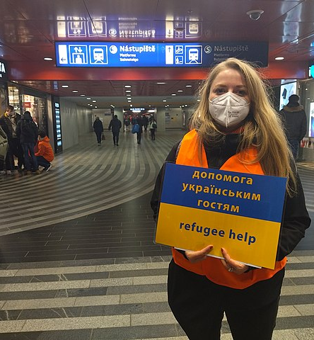
Ukrainian refugees being welcomed in Poland.
As hundreds of thousands of Ukrainians seek safety across Europe, many have travelled to Poland which is a neighbour of Ukraine.
Ordinary Polish people have collected food, water, and clothes for the Ukrainian refugees. They have opened their arms and their communities to offer safety.
This is a powerful example of love and reminder that lots of people are doing amazing things in the face of the crisis.
Photo from Wikimedia Commons. Photographer: Jan Beránek

Slide 4

Organisations like Christian Aid and DEC are doing all they can to help.
Christian Aid, like lots of charities, are raising money to get the right help to the people who need it the most.
Christian Aid is also campaigning alongside lots of other charities like Together with Refugees to call on the UK government to do everything they can to help support Ukrainians who are seeking safety here in the UK.
Photo by Katt Yukawa on Unsplash

