Slide 1
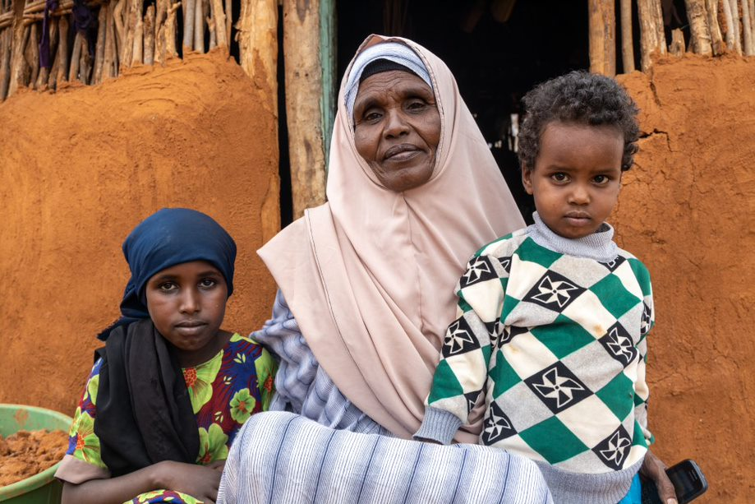
East Africa Crisis Appeal
Fatuma Said Kassim from the village of Qoloba, in Northern Kenya alongside her grandchildren.
Communities like Fatuma’s are facing the worst drought in 40 years following consecutive failed rainy seasons.
Photos: Norah Rotich

Slide 2
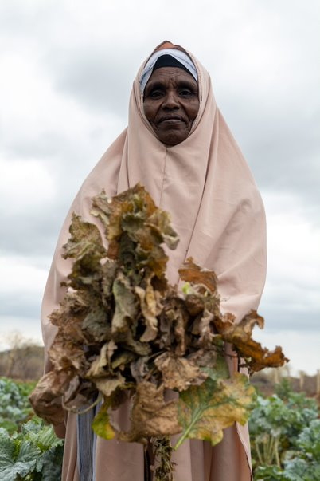
East Africa Crisis Appeal
18.4 million people across Kenya, Ethiopia and Somalia are missing meals or eating less diverse diets.
7.1 million children are malnourished in East Africa.
Millions of people are facing water shortages, many water points have dried up.

Slide 3
We are responding
Working through local partners, Christian Aid is responding to the severe drought in Ethiopia and Kenya.
Our partners are helping over 300,000 people by repairing wells, handing out water purification kits, providing cash support and trucking water to drought affected communities.
We are also providing fodder and medicine to keep valuable livestock alive.

Slide 4
How you can respond
You can donate at:
  caid.ie/eastafrica
  Or by phoning (028) 90648133 in Northern Ireland
  Or by phoning (01) 496 7040 in Republic of Ireland

Slide 5
Prayer for East Africa
Creator God,
The earth is yours and everything in it,
All people and all nations under your care,
Lord, we lift up to you the people of East Africa,
Where rivers have dried up,
rains have failed,
and crops have withered in the field.

Slide 6
Prayer for East Africa
We cry out to you for rain,
that the land may burst into life again.
That people may eat and be satisfied.
But, Lord we confess that this disaster is no surprise.
It is of our own making.
Our greed and carelessness with your precious earth
Has caused a climate crisis

Slide 7
Prayer for East Africa
And it is the poorest who pay the cost.
Forgive us Lord.
Create in us a heart for justice
Help us to share what we have.
So, that help may come urgently
to those in desperate need.

Slide 8
Prayer for East Africa
May our governments respond with financial support.
And may they show leadership in tackling the climate crisis
We cry out to you again for rain,
rain that will roll down like a river,
Until justice fills the earth again,
Amen.

Slide 9
Please donate today caid.ie/ChurchHarvest

