Slide 1
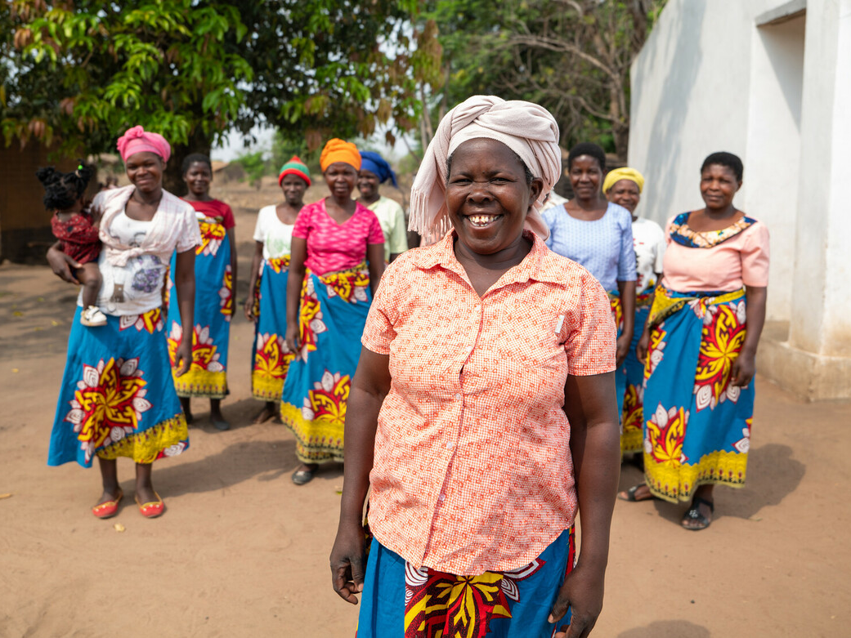

Notes:
I’m going to tell you a story about how something very, very small, is making a very, very BIG difference to the lives of lots and lots of people. Can you think of anything that, even though it is teeny tiny, can make a big difference?
Those are all great examples.
But none of you thought of the humble, little pea (show the children and example of a dried pea). So, I’m going to tell you the story of Esther, and her wonderful family, and how Christian Aid have introduced her to life-changing pigeon peas.

Slide 2
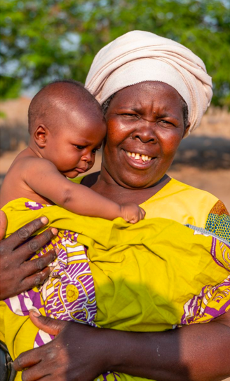
Esther and Nespo
Notes:
This is Esther with her grandson Nespo. He is very tiny and he loves his granny very much. There is something beautiful about Esther’s warm heart and everyday acts of kindness.

Slide 3
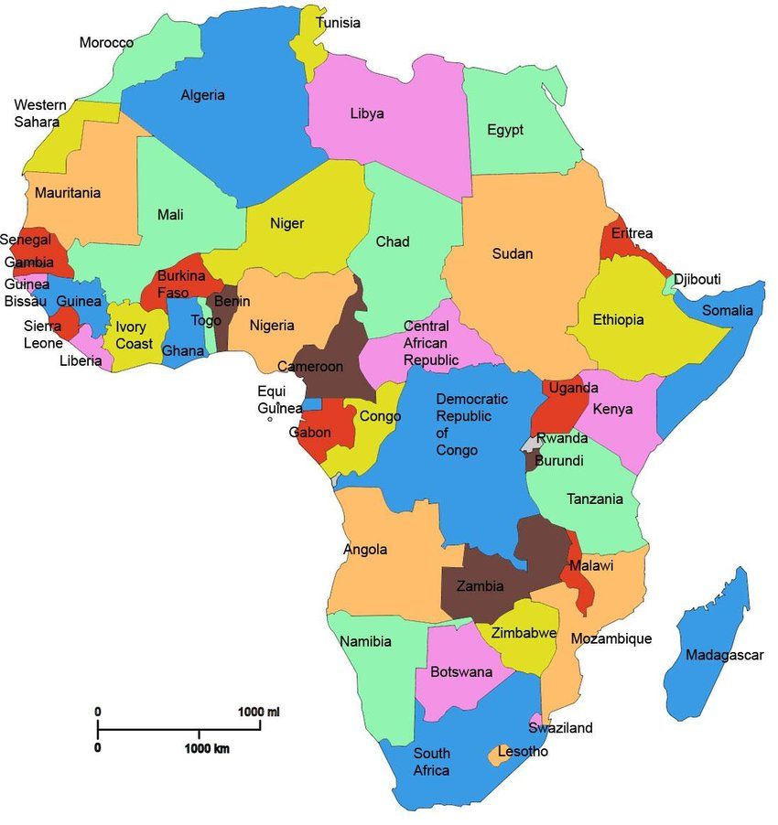


Malawi
Notes:
Esther and her family live in a country called Malawi, which is part of the continent of Africa. Have any of you ever heard of Malawi? Let me tell you a little bit about it.

Slide 4
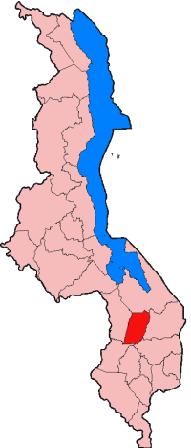

Balaka
Lilongwe
Notes:
The capital city of Malawi is called Lilongwe. It is a big city, with over one million people living in it. Esther and her family live in a place called Balaka, which is a township in the south of Malawi. It has schools, churches, a bank and shops. Does that sound a bit like where you live too?

Slide 5
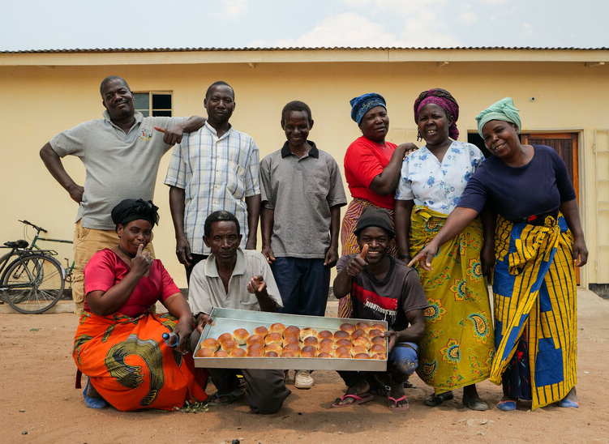
Notes:
The people of Malawi are known to be so friendly that Malawi is sometimes called the ‘Heart of Africa’!

Slide 6
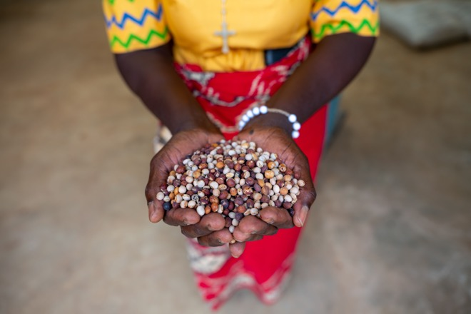
Notes:
Christian Aid loves to help farmers grow lots of delicious food. Which is why they are helping Esther and her family as they work hard on her farm to grow a very special crop that you can see here – the teeny tiny pigeon pea. They don’t really look like pigeons though, do they?! Why do you think they’re called pigeon peas? Those are all really good guesses! The reason they’re called that is that they used to be used to feed pigeons – but not anymore. Now, they’re being used to change lives!

Slide 7





Notes:
The reason Christian Aid is helping farmers in Malawi to grow pigeon peas is because they are a super pea! They are cheap and easy to grow. They don’t need lots of water. And they don’t need lots of fertilizer!
And this is great for Esther, and lots of other farmers, because the climate in Malawi is changing, which means less rain, and farming tools now cost an awful lot of money! Have you heard grown ups complaining about how expensive things are? It’s just the same in Malawi.

Slide 8
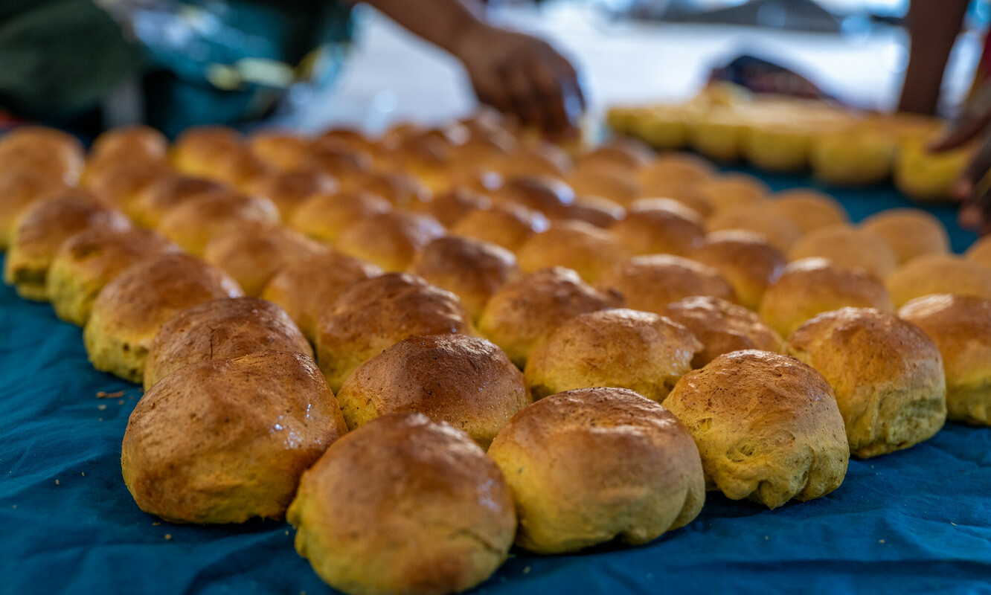
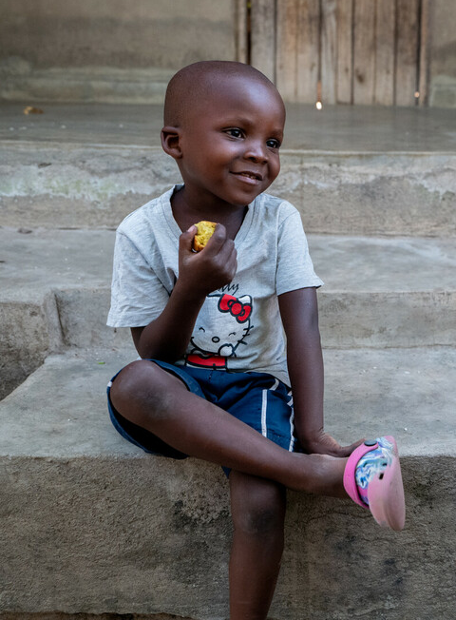
Notes:
Esther can use these super-peas to make lots of delicious food, including bread and stew, for her family and friends, and she can sell these to her community. Nespo absolutely loves his granny’s pigeon pea bread and gets very grumpy if she hasn’t made him any. It really does look delicious!

Slide 9
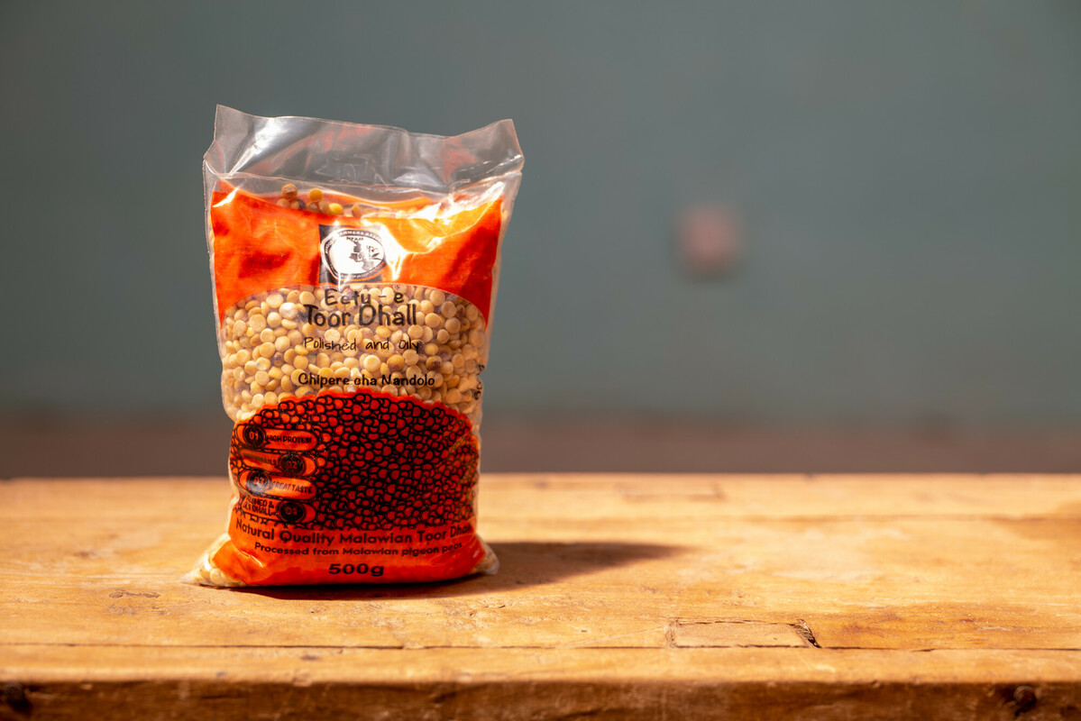

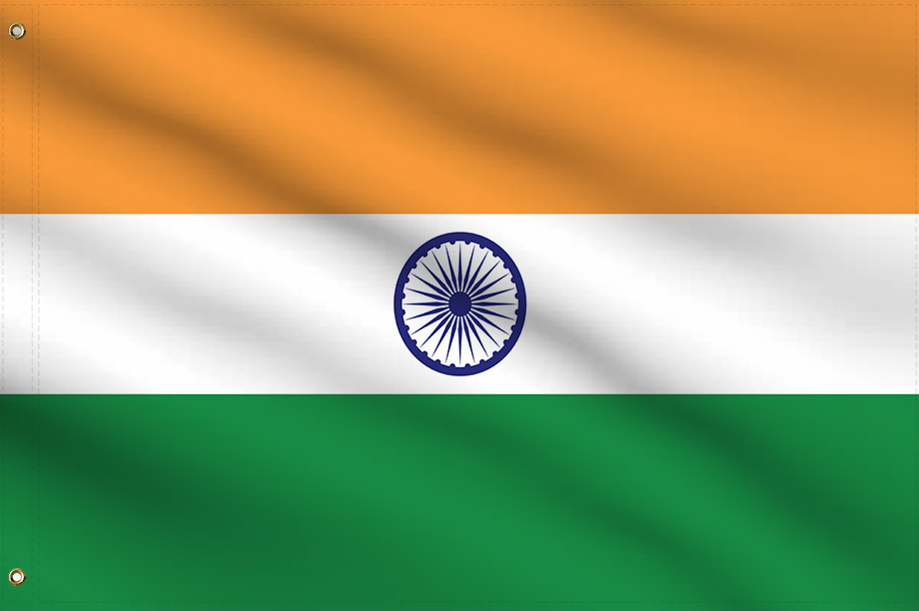

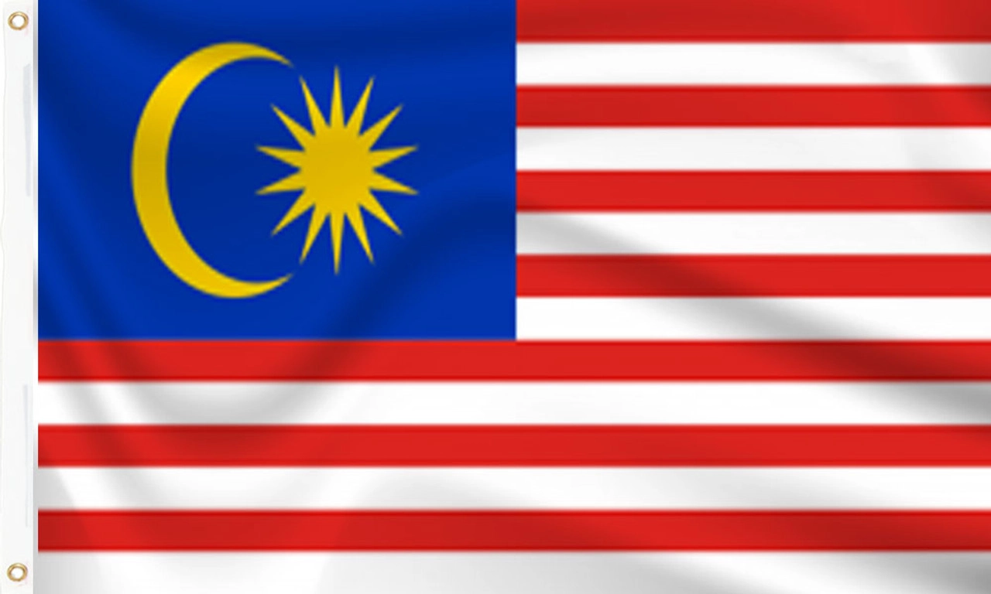
Notes:
With Christian Aid’s help, Esther is also able to sell her pigeon peas to large companies, for a good price, and these companies send the pigeon peas to countries all over the world, including India, Pakistan and Malaysia.

Slide 10


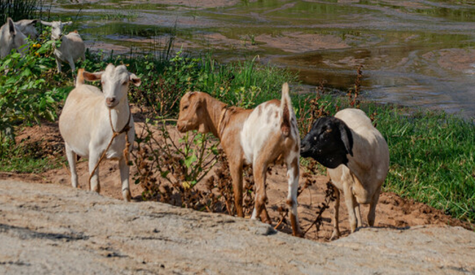
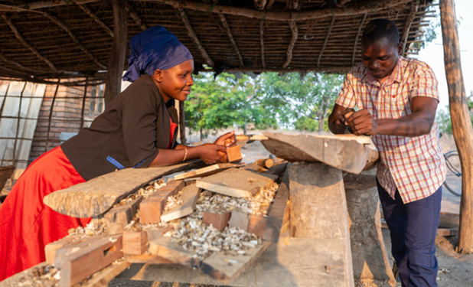
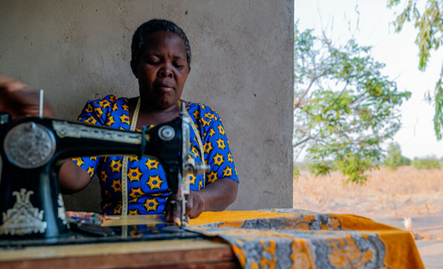
Notes:
With the money Esther has made from her pigeon peas, she has been able to: buy goats so that she can use their droppings as manure for her crops; buy a sewing machine so that she can make clothes for herself and her family; and she has been able to send her younger daughter to school and help her eldest daughter, Rashida, set up her own carpentry business. All these wonderful things, thanks to the teeny tiny super pigeon pea!

Slide 11
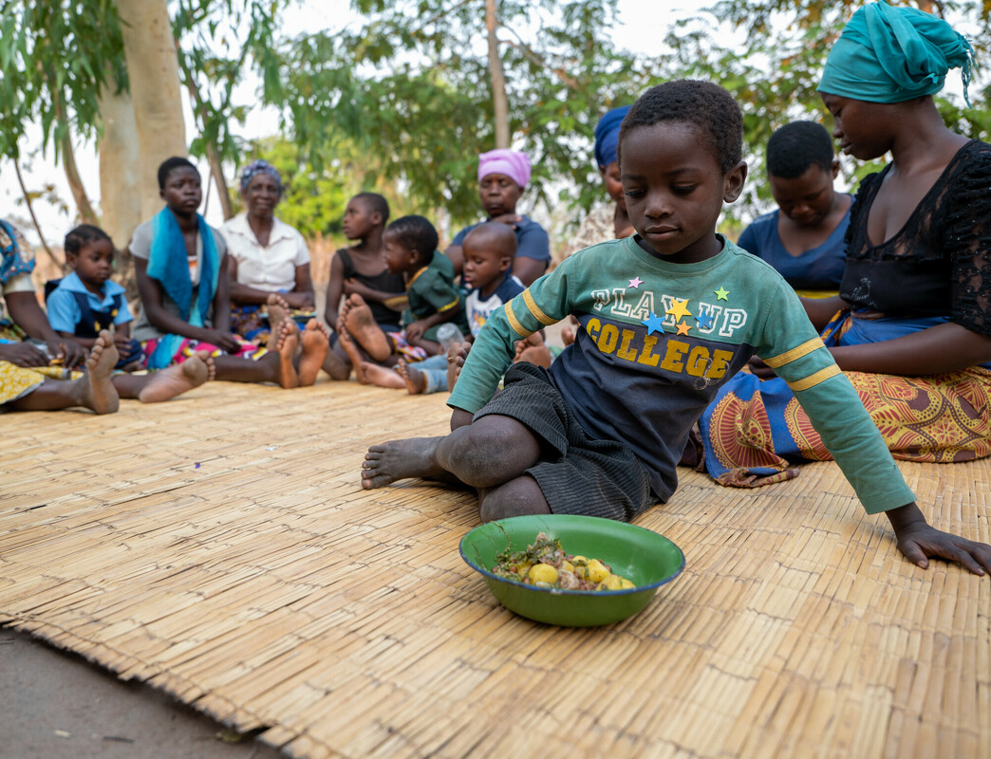
Notes:
Esther says: ‘We are a community that helps one another a lot… if people face a problem, we do not allow them to suffer alone.’ So, when you give to Christian Aid, you become part of Esther’s community of people who help one another and help make their lives better and their dreams come true.

Slide 12
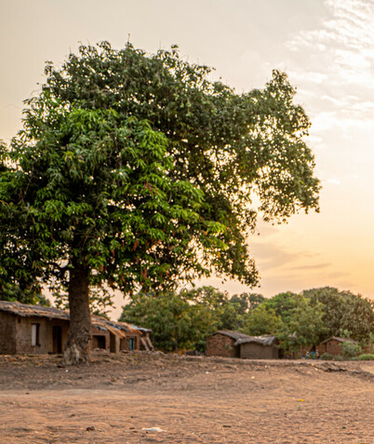
The kingdom of heaven is like a mustard seed that someone took and sowed in his field; it is the smallest of all the seeds, but when it has grown it is the greatest of shrubs and becomes a tree, so that the birds of the air come and make nests in its branches.
Matthew 13:31-32
Notes:
In the Bible, Jesus tells a story about how the Kingdom of Heaven is like very small seeds: ‘The kingdom of heaven is like a mustard seed that someone took and sowed in his field; it is the smallest of all the seeds, but when it has grown it is the greatest of shrubs and becomes a tree, so that the birds of the air come and make nests in its branches.’ (Matthew 13:31-32)
Isn’t it amazing to compare God’s very, very big Kingdom to very, very small seeds, because they are full of potential to grow into something beautiful and wonderful and life changing – just like the Kingdom of God.

Slide 13
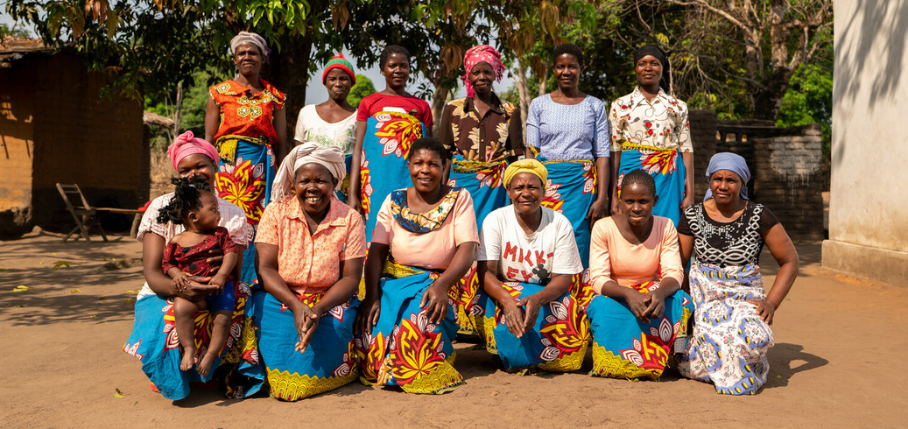
Together, we can help dreams come true
Notes:
We think that the work of Christian Aid, with people like Esther, is like the picture of the mustard seed that Jesus shares, because our projects in Malawi start with something very, very small – a pigeon pea. From that small beginning, we are seeing people grow into their full potential through education, through small businesses, and through hope for the future! And we want this picture of God’s Kingdom in Malawi to continue to grow and expand, just like that little seed, until everyone is able to live free from poverty.

Slide 14
Father God,
We give you thanks for the story of Esther and her community that helps each other.
May we learn and be inspired to be part of Your community that helps others and to help grow Your community around the world, so that everyone can experience life in all its fullness.
In Jesus’ name we pray,
Amen.
Thanksgiving Prayer
Changemakers Conference
Notes:
Let’s pray together:
Father God, Thank you for the story of Esther and her community that helps each other.
May we learn and be inspired to be part of Your community that helps others and to help grow Your community around the world, so that everyone can experience life in all its fullness. In Jesus’ name we pray,
Amen

