Slide 1
Christian Aid
Harvest Appeal 2023
Notes:
Notes to help you share Knowledge’s story
Good morning and welcome
You could use some of the talk ideas in our worship guide - faith-will-worship-resources-ni-roi-version-v2.pdf (christianaid.ie) – such as focusing on the idea of leaving a legacy being like planting a seed:
Harvest is a time when we say ‘thank you’ to God for all that we have, especially for the food we eat and those who produced it. When a farmer or a gardener plants a seed or a bulb, they have faith that it will grow up into a healthy plant. Some plants grow quickly. I wonder if anyone has ever sown any cress? If you’ve done that, you may have seen the seeds sprouting within a day. Or if anyone has planted a sunflower seed? A sunflower seed can grow to a plant that is 12 feet tall in three months! But some plants take much longer to grow!
[This and other ideas are fully scripted in the above worship resources]

Slide 2
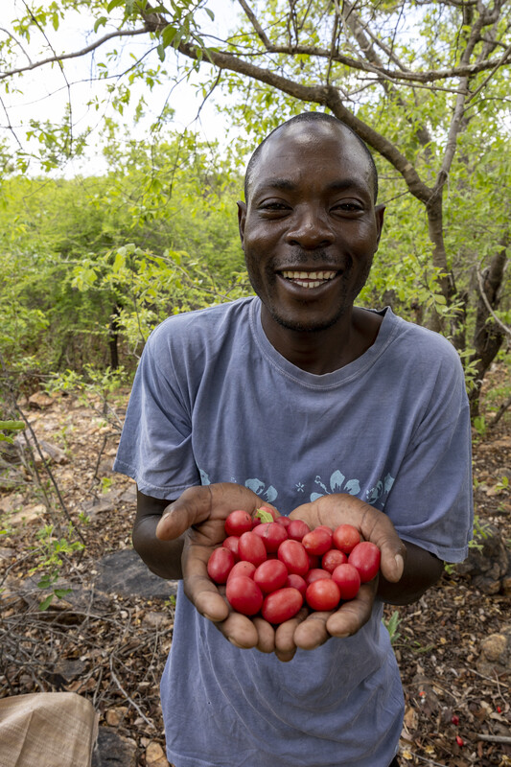
Knowledge Chikondo lives with his wife and three children in Kondo village, Zimbabwe.
Notes:
Knowledge’s full story can be found here - Knowledge's Story - Christian Aid Ireland
So you can find a lot more details there, and pick out the details you think will be helpful and inspiring to share.
Knowledge Chikondo is a 35-year-old farmer who knows all about the value of planting seeds and watching them grow!
He lives with his wife and three children in Kondo Village, Zimbabwe. Knowledge struggled to make a living as a farmer until he was helped by a Christian Aid project called BRACT, which is run by a group of four local partner organisation including Bio-Innovation Zimbabwe (BIZ) and Silveira House.
Knowledge explains: “When I first started farming, life was really tough. The weather was erratic. Some years we received decent rainfall but other years we got only a few very intense storms then nothing. I was growing groundnuts and sorghum, but yields were poor and the income I got was too low to support my family. I had a real problem finding decent markets and the buyers who I approached offered very low prices for my products.”
Knowledge heard about the BRACT project when BIZ came to his village to survey the types of wild fruit that were available, such as a fruit found locally called Nhengeni (Ximmenia caffra). Nhengeni seeds are valuable because they contain oil which can be extracted to make cosmetics.

Slide 3
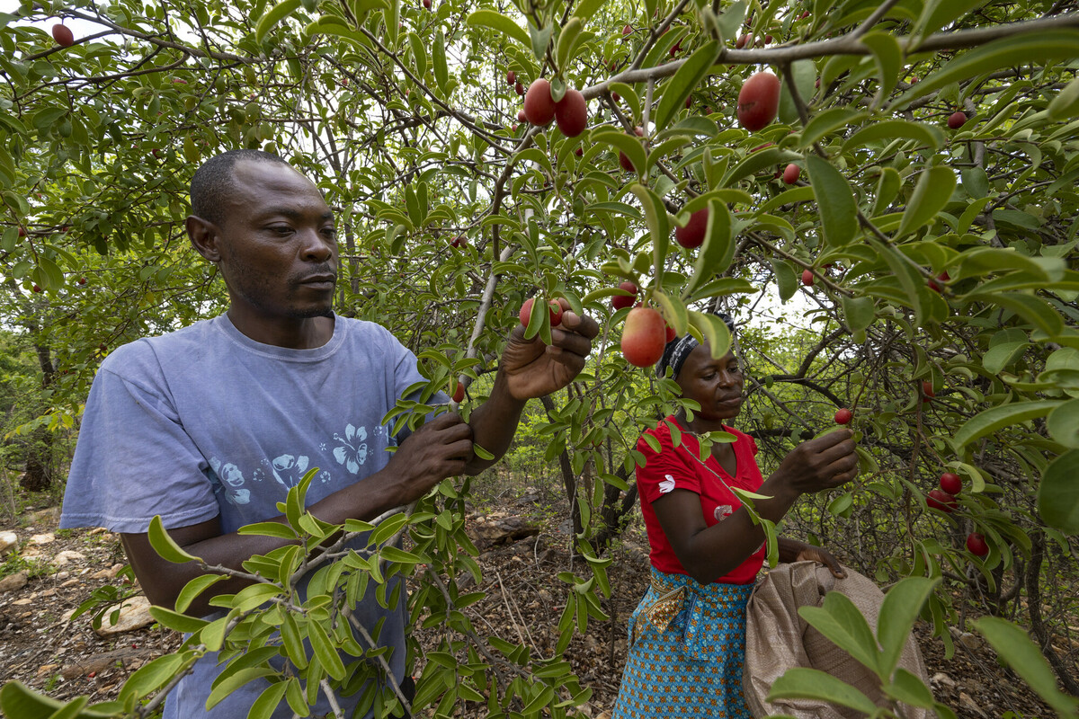
Knowledge received training from Christian Aid’s partner in harvesting and processing a wild fruit called Nhengeni
Notes:
Knowledge explains that “Harvesting must be done in a very hygienic way, so we wear clean clothes and take soap and a container of water with us to wash our hands regularly during harvesting.
To process the fruit, I have to remove the skin and wash the seed. It’s quite a process. I have to put the seed in a cloth bag and scrub it on the rock with sand. When the seed is clean, we sort it to remove any that are poor quality then we put it in a clean container and take it back to the homestead where I have made a drying structure using shade cloth supplied by BIZ. The seeds must not dry in the sun as this can affect some of the valuable chemicals that they contain.”

Slide 4
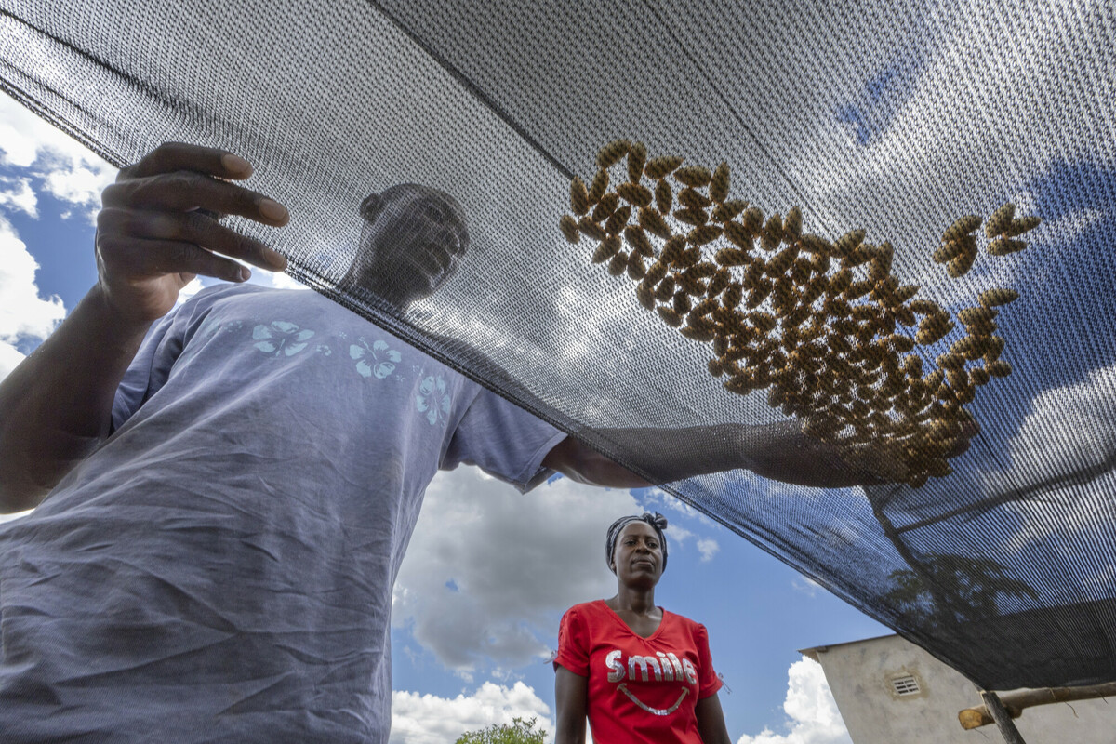
When collected and dried correctly Nhengeni seeds can be sold for use in cosmetics.
Notes:
Knowledge has also received training from another partner involved with the BRACT project called Silveira House. They have trained him to be a welder, which provides him with an alternative source of income. He is also part of a group that shares welding equipment and a savings and loans group as part of the project.

Slide 5
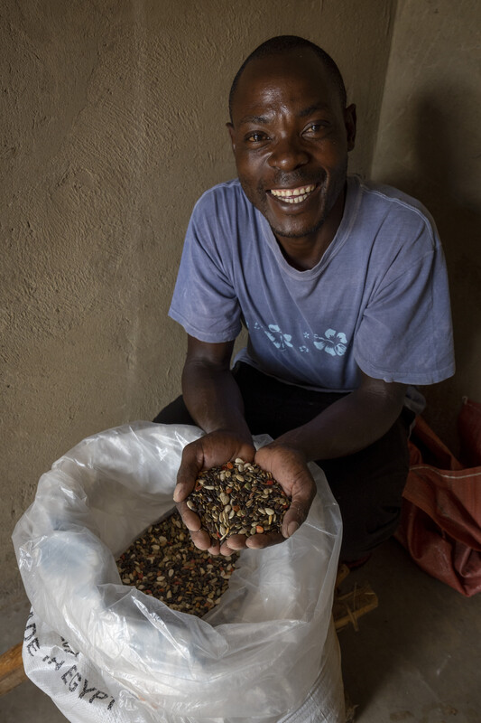
Knowledge says “I can provide for my family… when I first started collecting wild fruits my friends thought it was foolish but now that they have seen my success, they all want to join in.”
Notes:
Knowledge feels that his participation in the project has raised his standing in the community and he is better respected. He hopes to save enough money to buy a welding kit of his own and set up a welding business.
If you’ve supported Christian Aid in any way – whether through a monthly gift, through praying for us, through collecting for us or whatever action you’ve taken – you have been a part of this change in Knowledge’s life. Thank you.

Slide 6

“Now faith is being sure of what we hope for and certain of what we do not see.” Hebrews 11:1
Notes:
When we plant seeds, we have faith that they will grow up into tall and healthy plants. Of course, we don’t sit back and do nothing – we look after the plant by watering it, feeding it if necessary and weeding it. As we have talked about, some plants grow quickly – and we see the results of our work quickly. Other plants, such as trees, like the oak, take much longer to grow. But having faith means believing that the plant will grow – that something mighty like an oak tree will come from a tiny acorn and may live for 1,000 years.
This verse reminds us that we can’t always see the results of what we do immediately, and the impact might not be seen until long in the future – but it reminds us to have faith that good results – that may last forever – will come from the right actions. That can happen when someone leaves a gift in their will to the church and to Christian Aid. Think about how small acts of kindness can make a big difference to someone else’s life.
Can you think of some small acts you can do this week [take suggestions]. Can you be kind to someone at school who is being bullied or feeling left out? Can you pray for someone who is unwell and send them a card? Can you help out a bit more at home? Can you save something from your pocket money to give to charity? Or can you think of ways to raise money for charity – for example by doing some baking or washing some cars?
Are there any things you feel passionate about and want to change in the world? What can we do to help people who live in our local area? What can we do to help people who live further away?
Let’s remember that ‘mighty oaks from tiny acorns grow’, but that it can take a long time – 150 years in fact! And just like the one oak tree that can produce 10 million acorns, by having faith that God will bless our small actions, they can all add up to something much bigger – a movement of kindness that can change the world for the better, long into the future!

Slide 7
Pledging a Gift in your Will is a powerful way to ensure that your values will live on and can help create lasting change for communities both locally and globally.
For more information visit caid.ie/faithwill
Notes:
Close in prayer
This prayer, and other suggestions, can be found in the worship resources – faith-will-worship-resources-ni-roi-version-v2.pdf (christianaid.ie)
Dear God, Thank you for the small things of the world: the acorn that grows into a mighty oak, the smallest acts of kindness to others.
Sometimes the problems of the world feel too big for us to change.
Help us to have faith that even our little actions can make a difference, and that we can make a better world, in our local community and beyond. In Jesus’ name we pray.
Amen.

