Slide 1
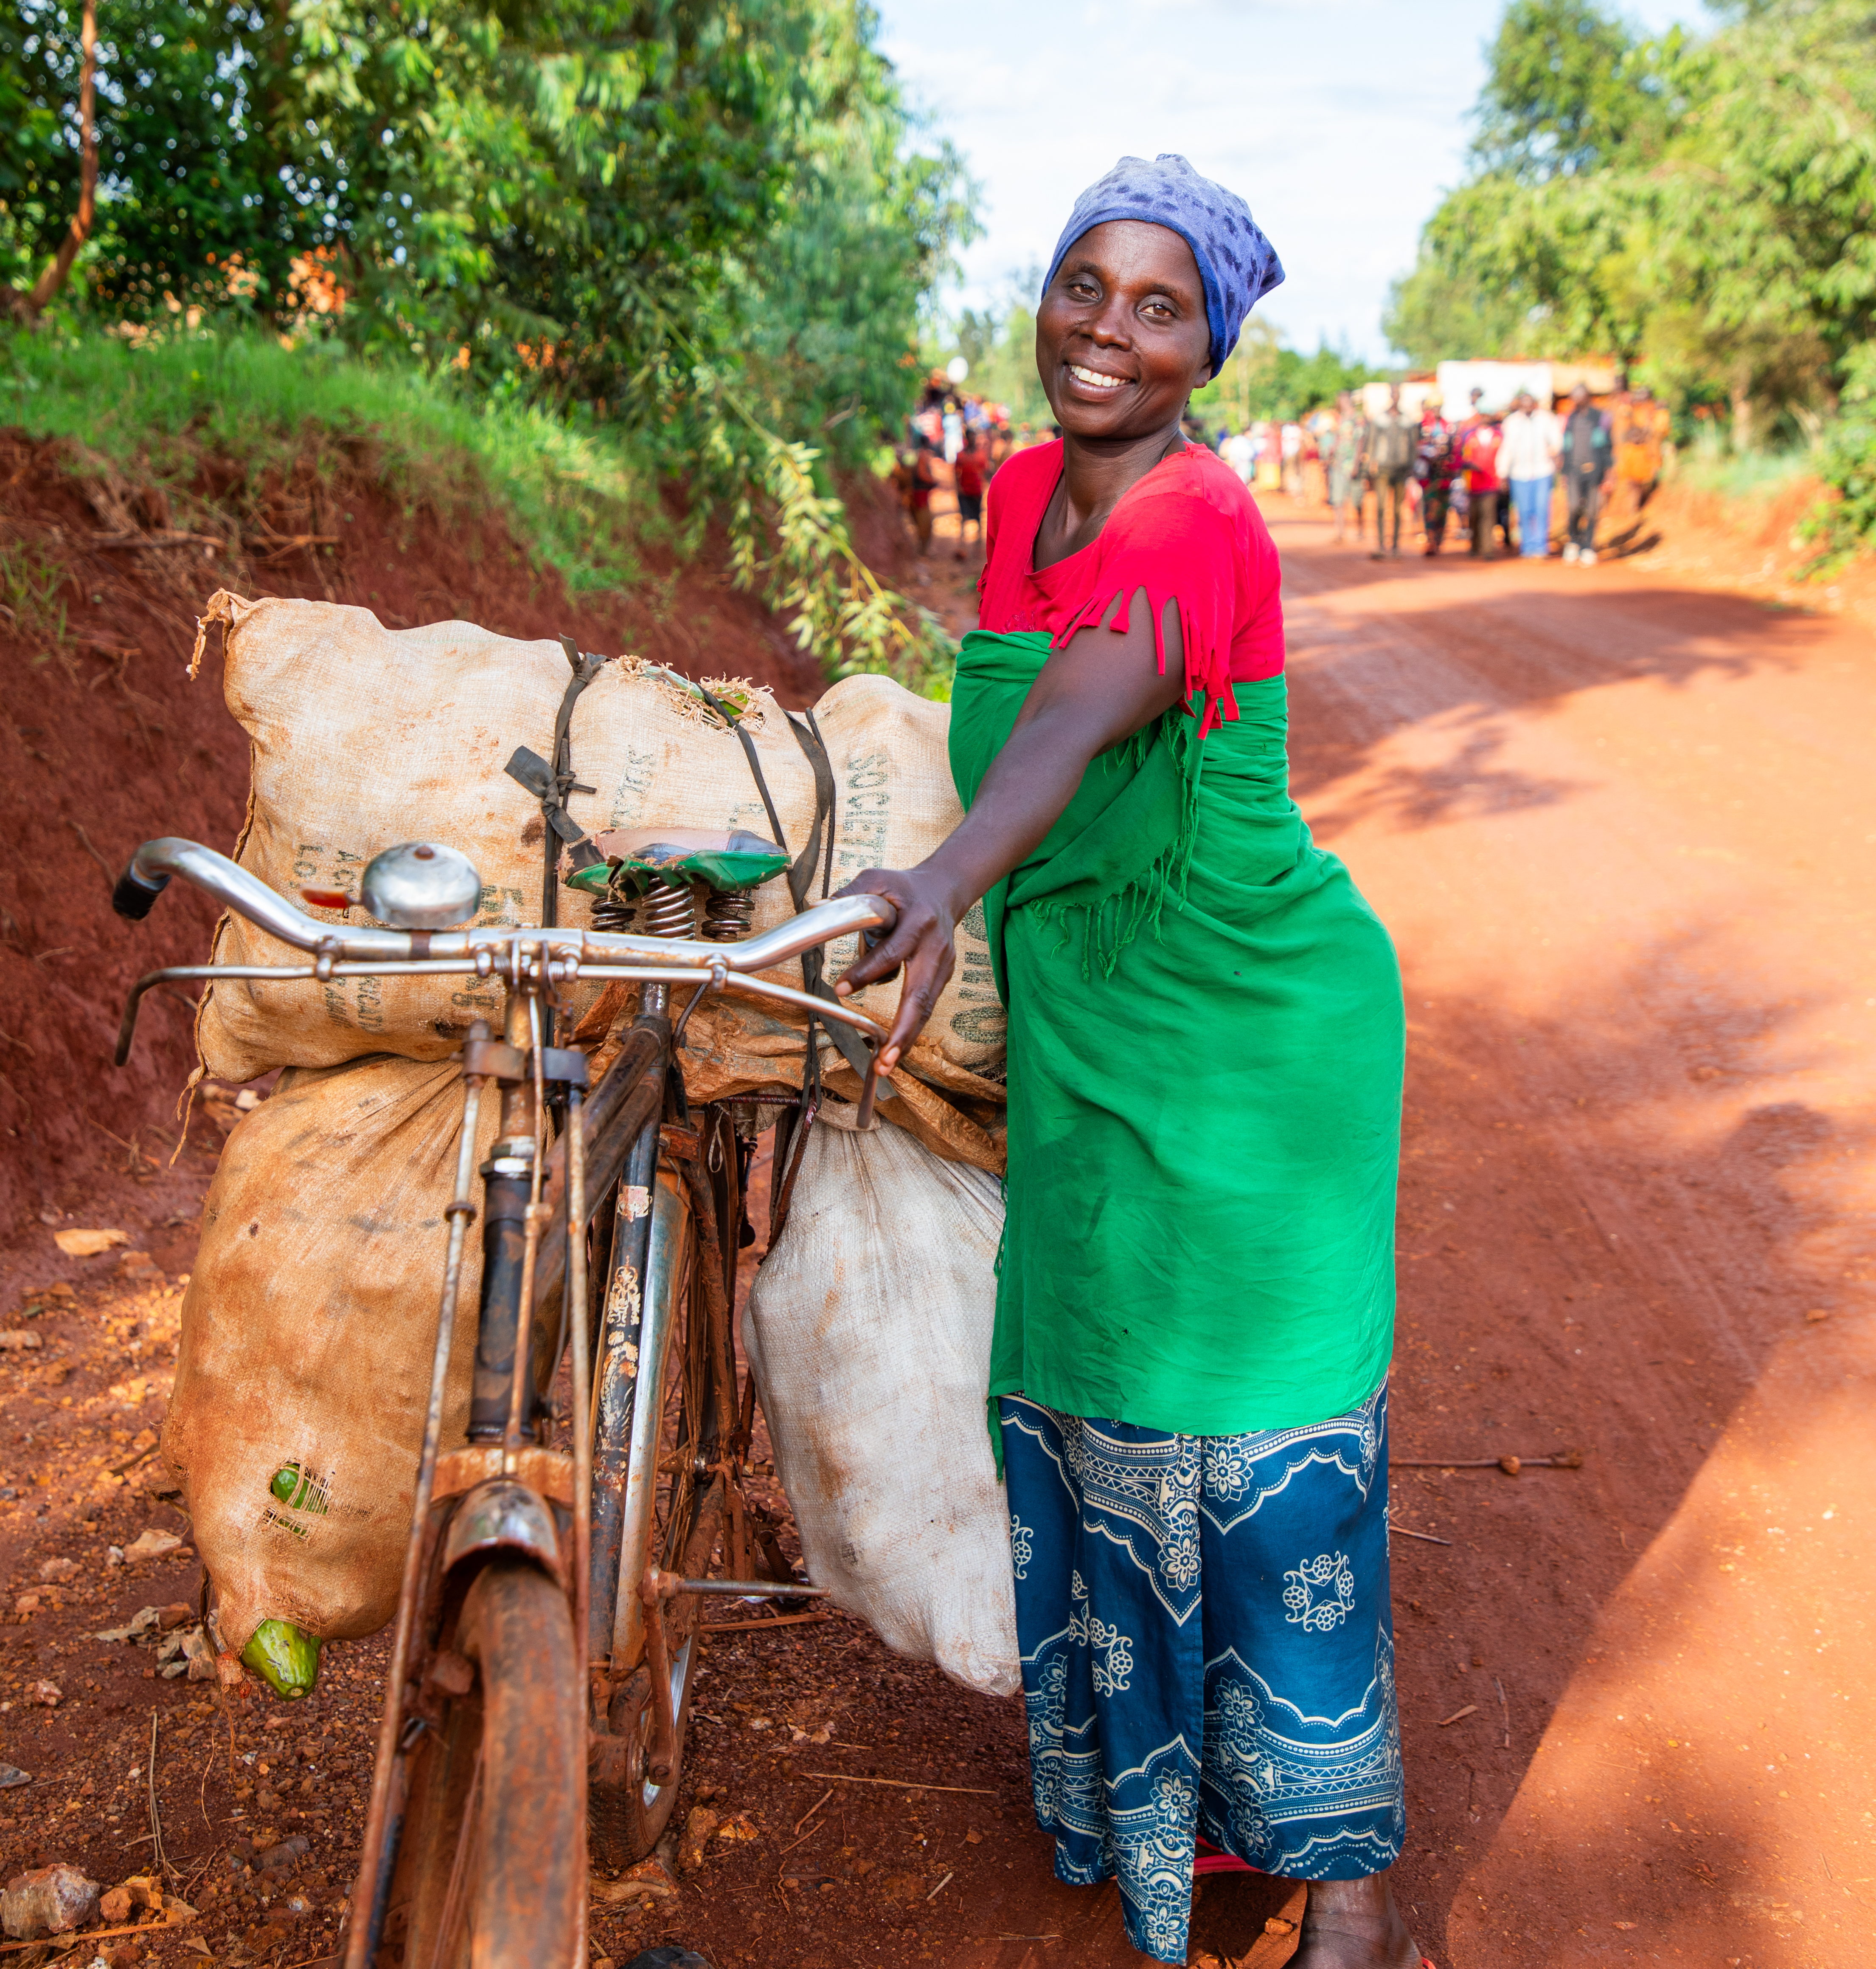
Aline’s story
Notes:
We’ll be hearing and reflecting on Aline’s story so we can learn a little bit more about the work of Christian Aid.

Slide 2
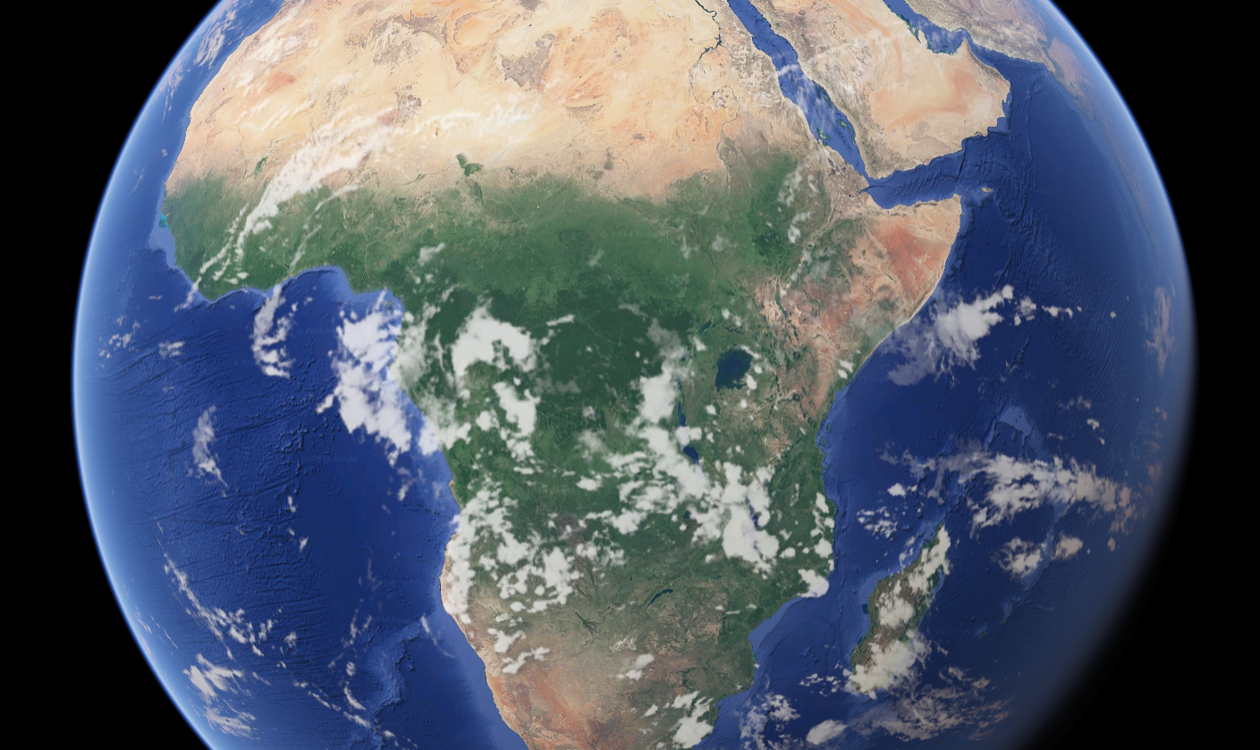
Aline is from Burundi
Notes:
Aline is from Burundi. Does anyone know roughly where Burundi is?

Slide 3
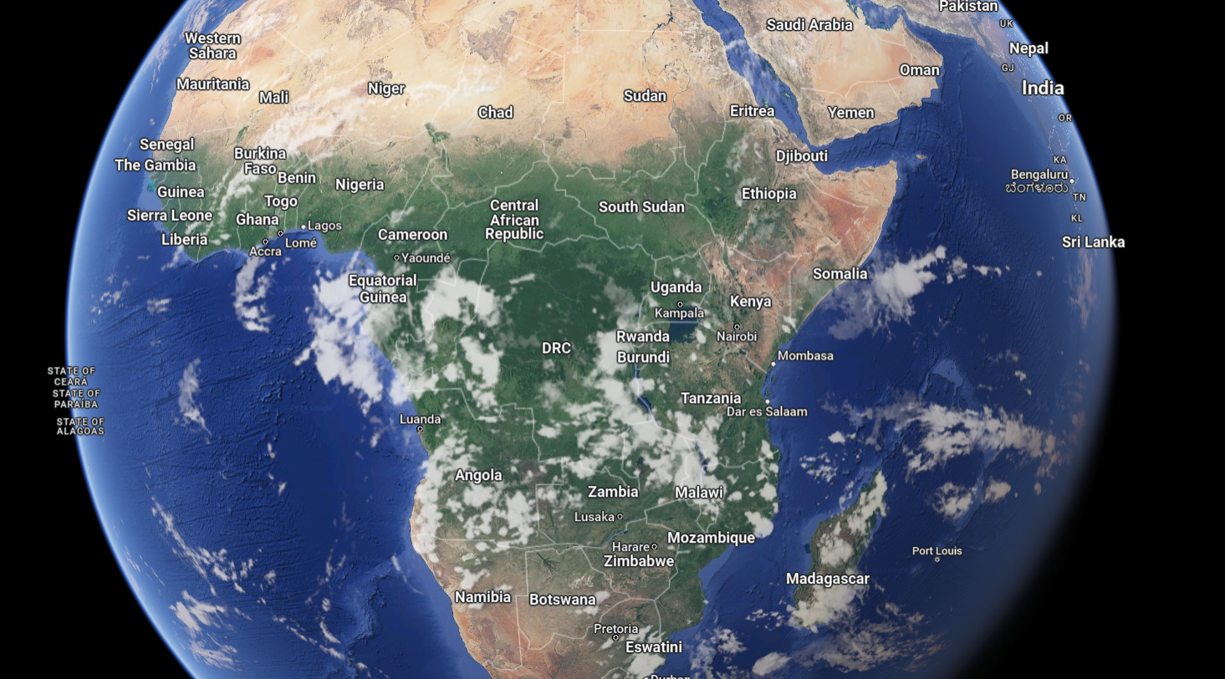
Notes:
Highlight where Burundi is on the map now you can see it clearly labeled. Burundi is in central Africa. It’s a very mountainous country. Burundi is one of the poorest countries in the world. Many people live in poverty, and most rely on farming to provide food to both eat and sell. Christian Aid has three local partners in Burundi that have vital local knowledge, understanding of the community, and specialist knowledge. Christian Aid supports and invests in local partners who are then able to deliver even more life changing support. (add partner names to ppt).

Slide 4
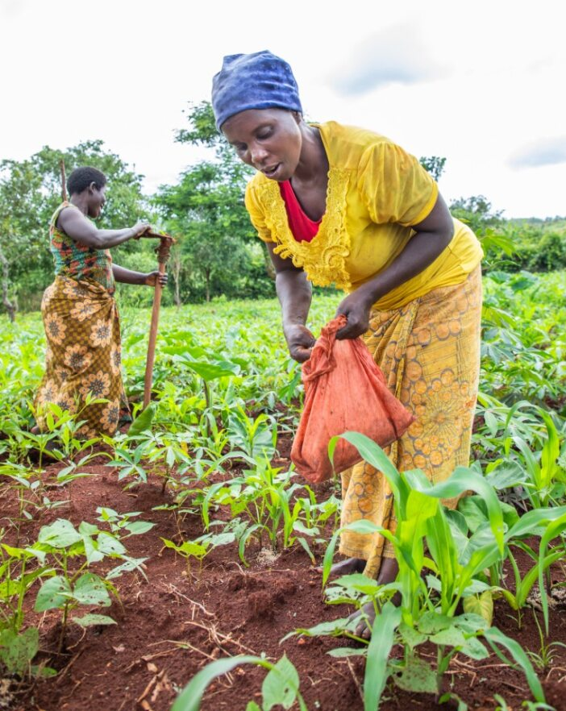
Farming is an important part of life for many families in Burundi.
Some of the crops they grow include sweet potatoes, peas, bananas, tea and coffee.
It is getting harder to farm in Burundi because of the climate crisis.
Notes:
Families in Burundi grow fruit and vegetables such as bananas, sweet potatoes and beans, plus sugarcane, tea and coffee. Farming is hard work, but it’s being made even harder because Burundi, like many places, is being affected by the climate crisis. Many farmers see their crops failing due to extreme weather events such as droughts and floods.
Families face many other challenges as well. Just like in the UK, the cost of everyday essential items is going up. In Burundi, most families don’t have a water supply to their home, so they must collect water from rivers or shared water points. Healthcare is very expensive, and you often have to travel a long way to see a doctor or nurse.
The challenges that communities like Aline’s face are made even harder as the climate crisis get worse. It’s a heart-breaking reality that the crisis is having the most severe impact in places like Burundi where life was already challenging enough. Furthermore, the people of Burundi are among those who’ve done the least to cause the climate crisis in the first place.

Slide 5
Questions for Discussion
How do you think people in Burundi, like Aline, feel when despite their hard work, the crops that they’re growing to make a living and feed their families fail?
Have you ever experienced something similar? How did it leave you feeling?
Notes:
Give the groups two minutes to share their thoughts – ask for one or two volunteers to share their group’s responses.

Slide 6
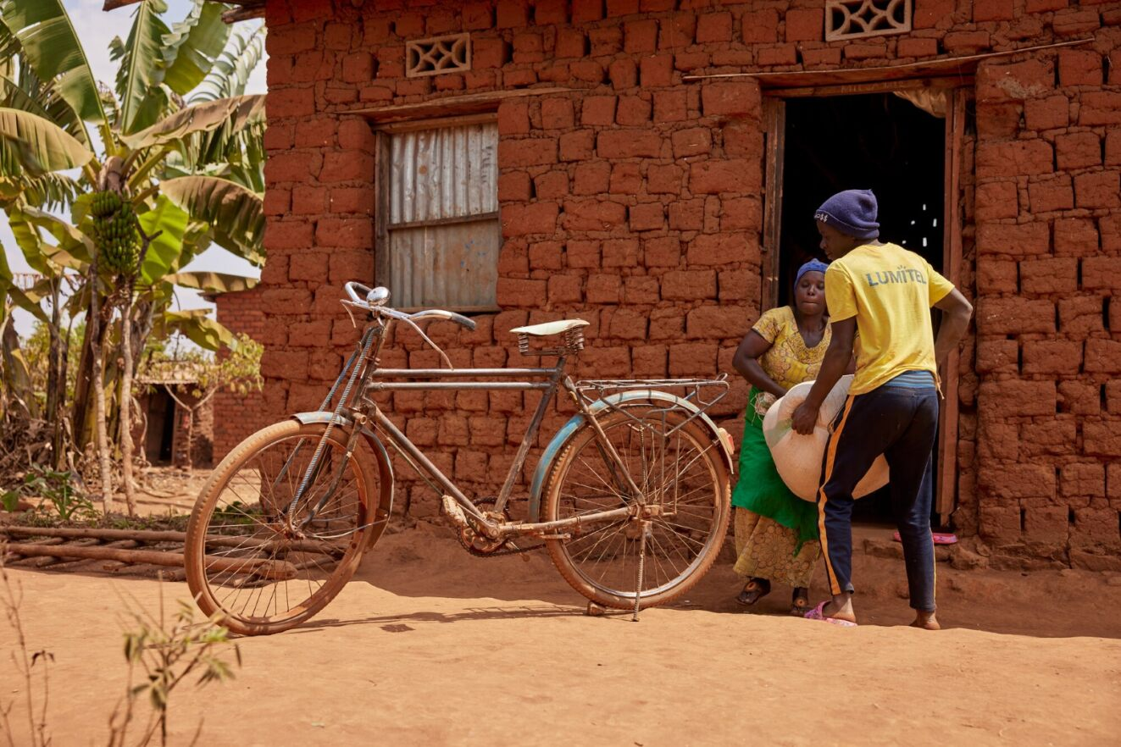
Notes:
Life in Burundi is tough, but Aline had an especially difficult life as a young person and for many years after. At one time she didn’t even have a place to live. Alone, hungry and with nowhere safe to go, she was very vulnerable. Aline lost so much, but she didn’t lose hope.
Determined and resilient, Aline found support through Christian Aid’s partners in her community. Aline received training that meant she had the skills and knowledge to set up a small business and form a Village Savings and Loans Association with other local people. Aline and her neighbours contributed money to a shared pot that became available as loans for members, as and when they needed them. Aline took a small loan to set up her own business selling peanuts and avocados.
Through her business, Aline has been able to buy a bike, build her own home, get better access to healthcare, and educate her family.

Slide 7
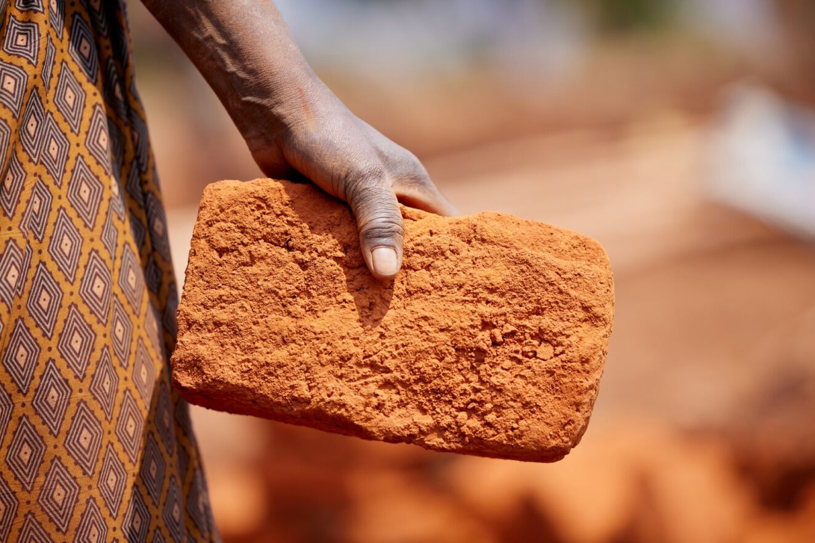
Notes:
Aline hasn’t stopped there though. She’s now the chairperson of a Village Savings and Loans Association that she’s founded. Aline’s using her experience to help transform the lives of other families who want to do the same and build a brighter future together. Now, when crops fail, storms damage homes, and people fall ill, this community is in a position to work together to overcome these challenges.

Slide 8
‘The members thank me for the training and the positive impact it has had on their daily lives. People come to me as they trust me. Here in Burundi, a neighbour is considered a member of the family.’
Aline Nibogora

Slide 9
Questions for Discussion
How has Aline's life been transformed?
Have you ever experienced a transformation like this in your own life?
What does it look like to put love into action in our community?
Notes:
Give the groups two minutes to share their thoughts – ask for one or two volunteers to share their group’s responses.

Slide 10
Prayer Time

