Slide 1
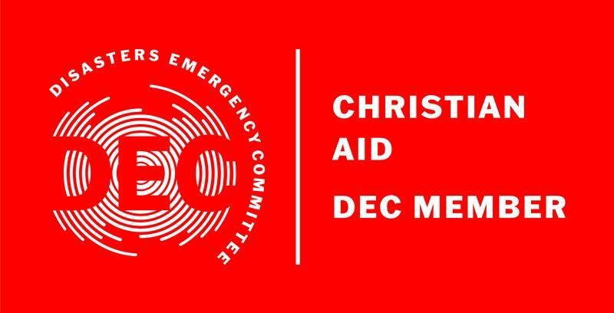
Middle East Crisis Appeal

Slide 2
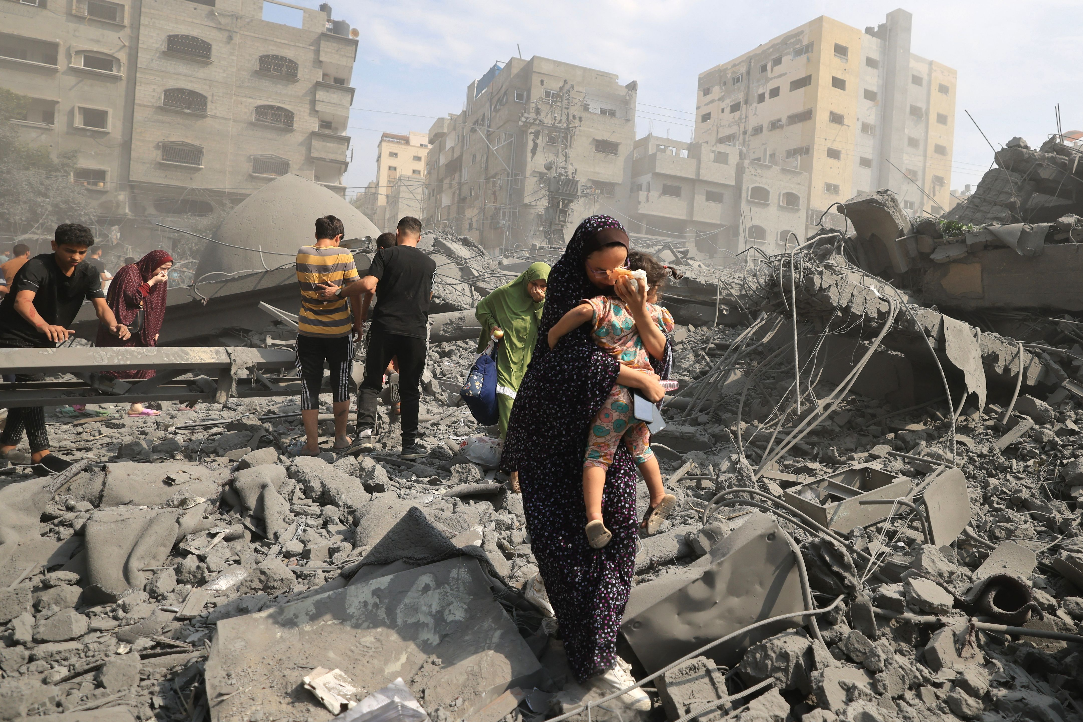
Israel and the occupied Palestinian territory

Slide 3
Overview
Thousands have been killed and many more injured, this is the deadliest attack Israel has seen in decades. Airstrikes have caused widespread destruction of homes, schools, and healthcare facilities.
Hospitals that are already at breaking point are overwhelmed by casualties while hundreds of thousands of people displaced.

Slide 4
Christian Aid’s response
Christian Aid has been working with the poorest and most vulnerable people in the Middle East since the 1950.
We already have trusted humanitarian partners based in Gaza, ready to respond with medical relief, food, shelter and sanitation, as soon as it’s safe to do so.
We're also actively exploring how we can support Israeli civilians who’ve been directly affected by the violence.
Notes:
Christian Aid response and content:
Christian Aid’s established partners in Gaza are ready to respond with medical relief and community-led initiatives such as food, shelter, sanitation and protection.
As background:
Christian Aid has been working with the poorest and most vulnerable people in the Middle East since the early 1950s, when we provided humanitarian relief to Palestinian refugees.
Today, as Palestinians continue to experience exile, blockade, relentless spikes in violence and huge increases in land dispossession, we work with Palestinian and Israeli partners to protect human rights and promote resilience for Palestinian communities and civil society.
We're also actively exploring how we can support Israeli civilians who’ve been directly affected by the violence.
by supporting Christian aid Your church can save lives. But the situation is changing daily, and we must act quickly. We already have trusted humanitarian partners based in Gaza, ready to respond with medical relief, food, shelter and sanitation, as soon as it’s safe to do so.
We're also actively exploring how we can support Israeli civilians who’ve been directly affected by the violence.
All our work aims to support the foundations for a just, lasting peace for all.
Protect, promote and defend human rights for the protection of Palestinians in the Middle East.
Strengthen the resilience of individuals, communities and institutions, so they can respond when faced with threats to their lives, land and livelihoods.
Deliver humanitarian responses that are accountable, impartial and strengthen local capacity.

Slide 5
The conflict is escalating
‘‘We didn’t sleep last night. We are so scared. Many people have been killed…there are also many families that are now living on the streets.’’
Christian Aid partner organisation in Gaza
Notes:
We don’t currently have pictures to share with you. Our partners are working in the most devastating of circumstances. We’ll update our website and social media with images when they are available.
Our long established partners in the region are on the ground now, ready to respond as soon as it is safe to do so. But the impact of the crisis is huge, and we need help from churches like yours to reach as many people as possible. Your donation today could help provide vital emergency supplies such as medical relief, food, and shelter.
If your congregation is not able to hold a collection today, please still use the resources we have created to help your church prayerfully respond to this crisis.

Slide 6
United by hope…
‘We struggle to keep our hope, but we are taking hope from and the eyes of our children and your solidarity during very hard times, these difficult and critical times that we are living in Gaza right now. We need nothing but peace, love and justice.’
Christian Aid partner in Gaza

Slide 7
A prayer for peace
O God of all justice and peace we cry out to you in the midst of the pain and trauma of violence and fear which prevails in the Holy Land.
Be with those who need you in these days of suffering; we pray for people of all faiths - Jews, Muslims and Christians and for all people of the land.

Slide 8
While we pray to you, O Lord, for an end to violence and the establishment of peace, we also call for you to bring justice and equity to the peoples.
Guide us into your kingdom where all people are treated with dignity and honour as your children for to all of us you are our Heavenly Father.
In Jesus’ name we pray. Amen
Notes:
A prayer for peace in the Middle East written by The Very Revd Canon Richard Swell, Dean of St George's College Jerusalem.

Slide 9
Prayer Points
For an end to the conflict
All parties to abide by international law
That the dignity and value of every life be valued
For lasting peace and justice
Notes:
Use these pointers to create your own prayer for peace, justice and reconciliation

Slide 10
Your response
By donating today, you can support Christian Aid’s established partners in Gaza to respond with medical relief and community-led initiatives such as food, shelter, sanitation and protection, as soon as it’s safe to do so.
Notes:
By holding a church collection, your church can reach those most affected. Together, we can be a beacon of hope in a time of darkness.

Slide 11
How to donate:
Hand your donation to your church rep
Visit christianaid.ie to donate online
Notes:
Thank you for showing those caught up in this terrible crisis that they have a community of people supporting them.

Slide 12
“Every war is a defeat. We urge both sides to abide by international law, to protect innocent civilians, and agree to an immediate de-escalation. The people in Gaza were already on their knees. Half of the population are children and have known nothing but blockade and conflict.”
William Bell, Christian Aid’s Head of Middle East Policy & Advocacy

