Slide 1


Christmas with Christian Aid

Slide 2
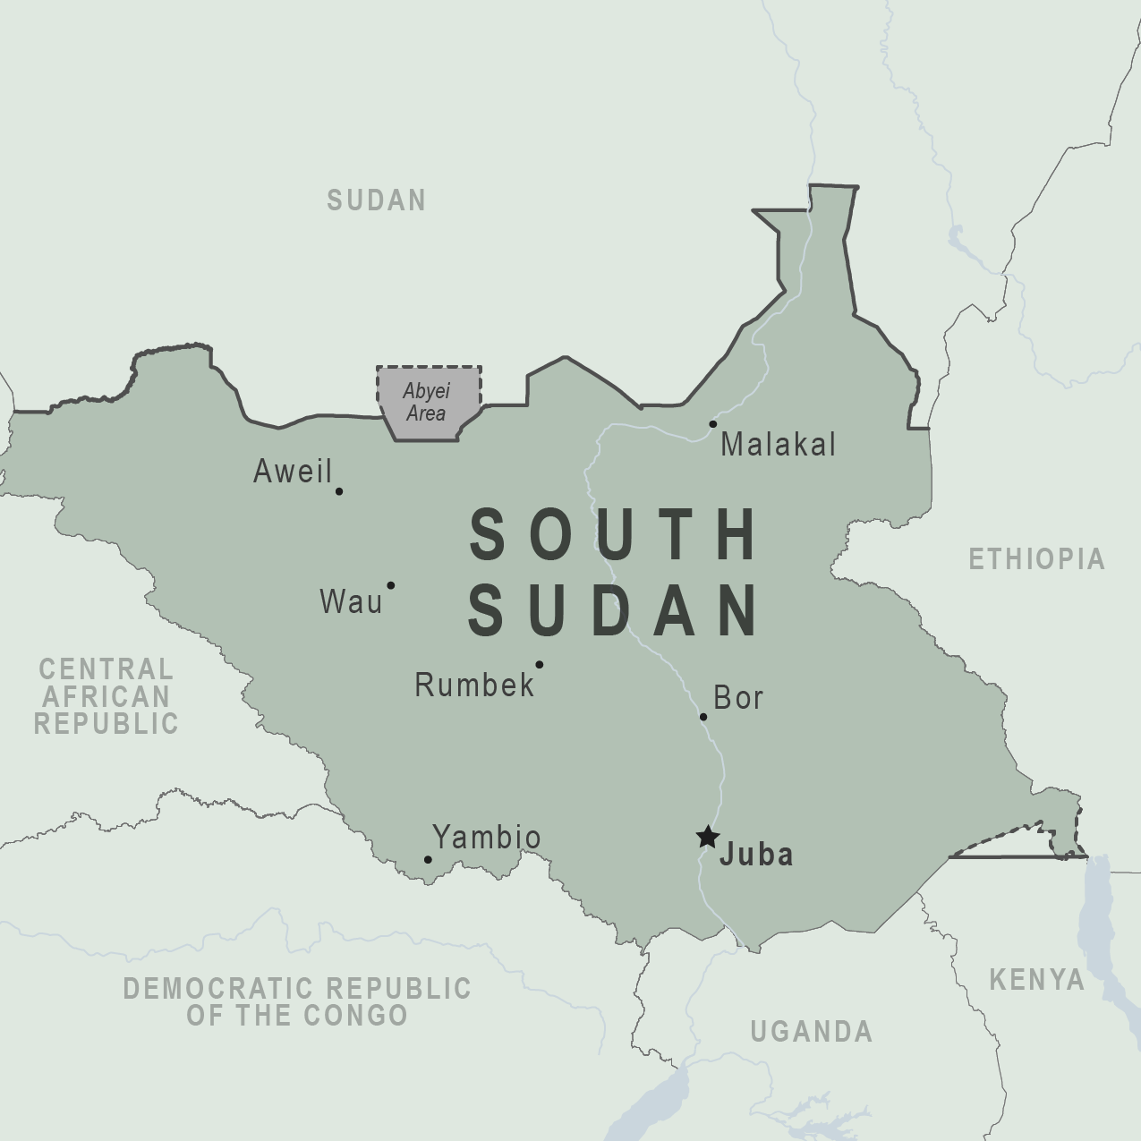
South Sudan
Considered the poorest
country in the world
Only 1% of secondary aged
children are enrolled
in school
About 90% of the population
rely on traditional farming
for their income
Conflict and extreme weather
make farming difficult.
This Photo by Unknown Author is licensed under CC BY-SA

Slide 3

Reading: Matthew 2:13-15 (NIV)
The Escape to Egypt
¹³ When they had gone, an angel of the Lord appeared to Joseph in a dream. “Get up,” he said, “take the child and his mother and escape to Egypt. Stay there until I tell you, for Herod is going to search for the child to kill him.”
¹⁴ So he got up, took the child and his mother during the night and left for Egypt, ¹⁵ where he stayed until the death of Herod. And so was fulfilled what the Lord had said through the prophet: “Out of Egypt I called my son.”

Slide 4





Discussion Activity
What makes you feel comfortable in your home and in your community? How do these things make you feel safe and secure?
Build up a collage of items that make your everyday life possible. If your group comes up with ideas that aren’t shown in the pictures, draw them.

Slide 5
Practical Activity
You must leave your home immediately! You may not ever be able to come back, and I can’t tell you where you are going and for how long.
You only have three minutes to pack your bags and get out of your home.
What will you bring and what will you leave behind?

Slide 6
Discussion Activity
What other considerations do you as a group think that you would need to make as you leave your home and your community?
How has this activity made you feel as an individual
and as a member of your group?

Slide 7
Unpacking Together
120 million people worldwide have had to face the reality of leaving home like this.
In South Sudan, over one third of the population are displaced.
War broke out in neighbouring Sudan in April 2023, forcing more people to come to South Sudan as refugees.

Slide 8
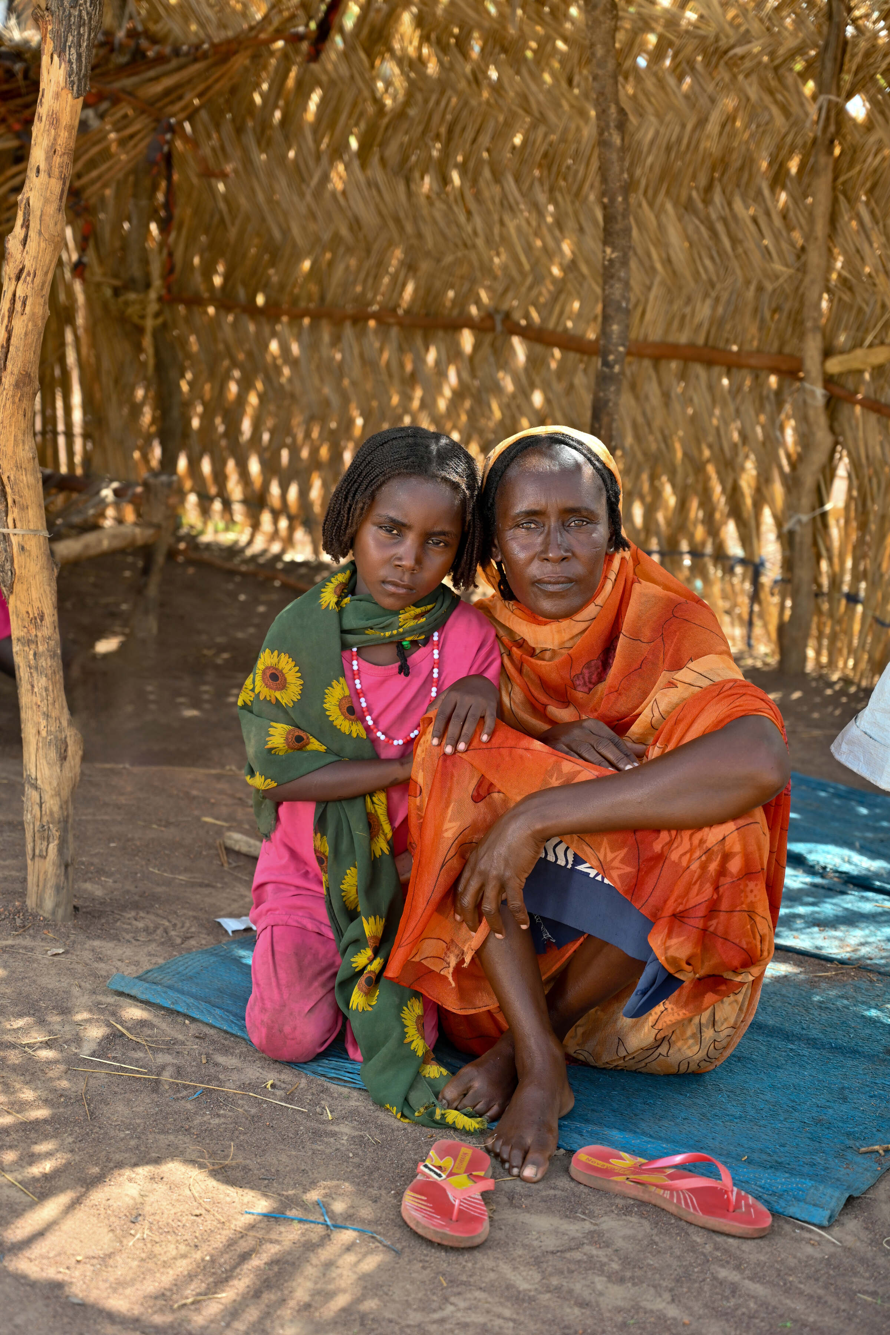
Shede’s Story
Shede is from the city of El-Daein in Darfur, Sudan. She’s married with three daughters.
The youngest, Saida, is six years old. Her eldest daughter also has a six year-old daughter, Mariem.
Before the war, Shede worked in a restaurant and enjoyed tending her organic farm.
As conflict tore through Sudan, Shede’s family was torn apart. She made the courageous decision to travel to South Sudan to protect the lives of her children and grandchild.
Christian Aid / David Macharia

Slide 9
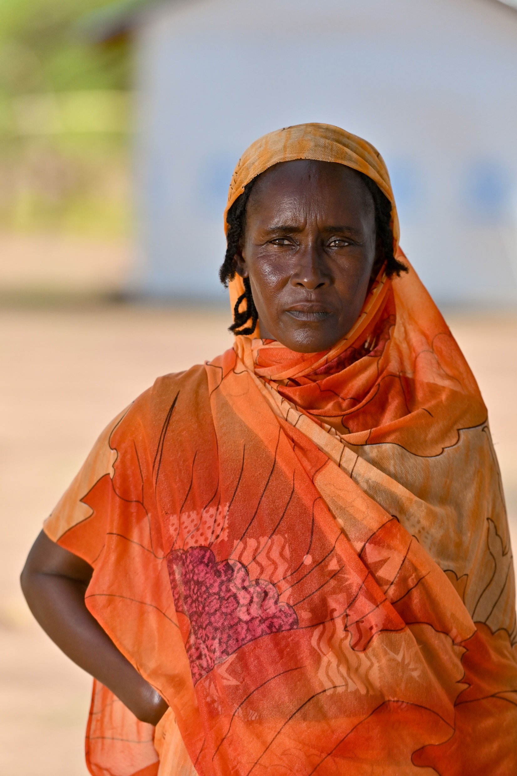
“I did not come with anything. I only came with these clothes on. The rest of my belongings were all left behind. No table, no teapot, no chair, no bed. Nothing. I left all my belongings behind.”
– Shede
Christian Aid / David Macharia

Slide 10
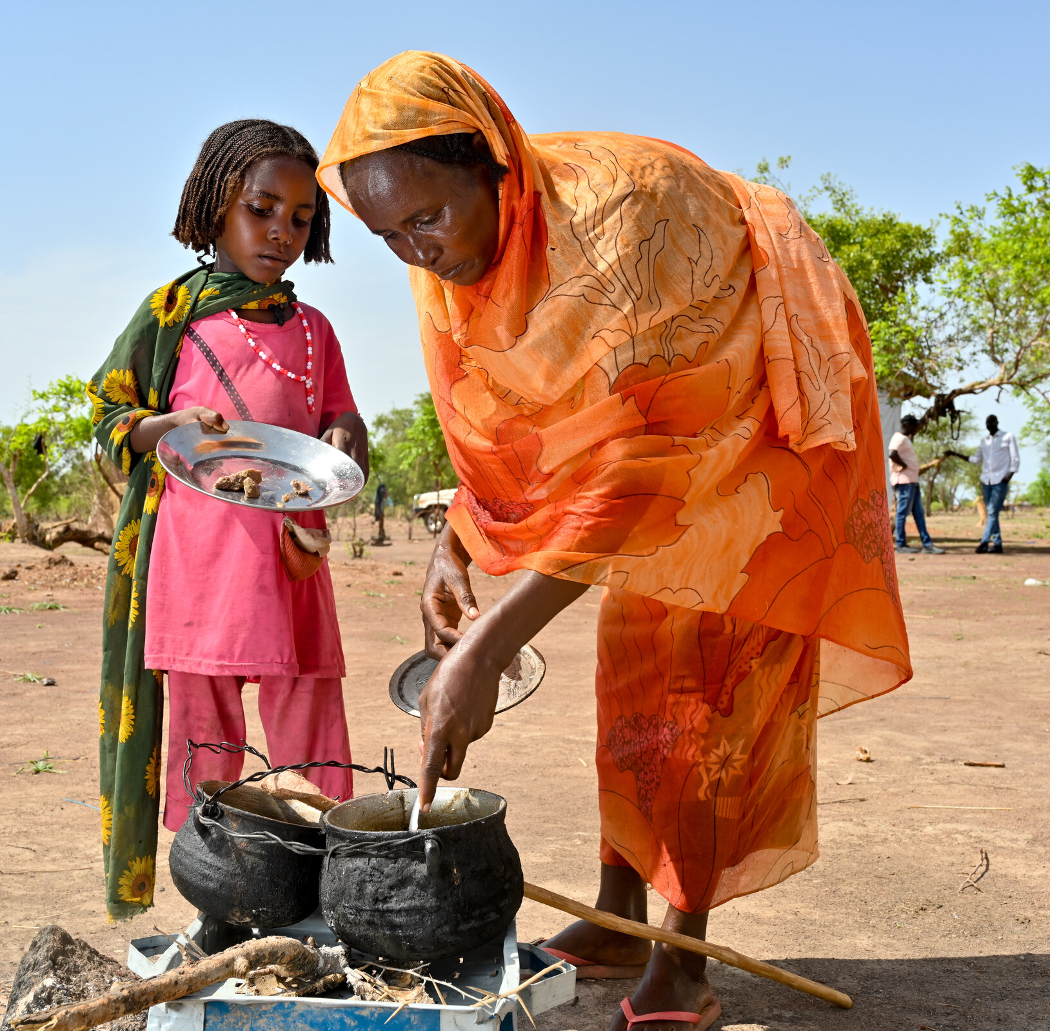
Now, Shede lives with the two little girls in a UNHCR (United Nations High Commissioner for Refugees) shelter at Wedweil Refugee Settlement in South Sudan.
Her older daughters have continued their journey, looking for work to support the family.
Christian Aid works in the settlement with their partner, Smile Again Africa Development Organisation (SAADO), to offer financial support to Shede and thousands like her.
This financial assistance means Shede can buy nutritious food for Saida and Mariem to protect them from malnutrition and ill health.
Christian Aid / David Macharia

Slide 11
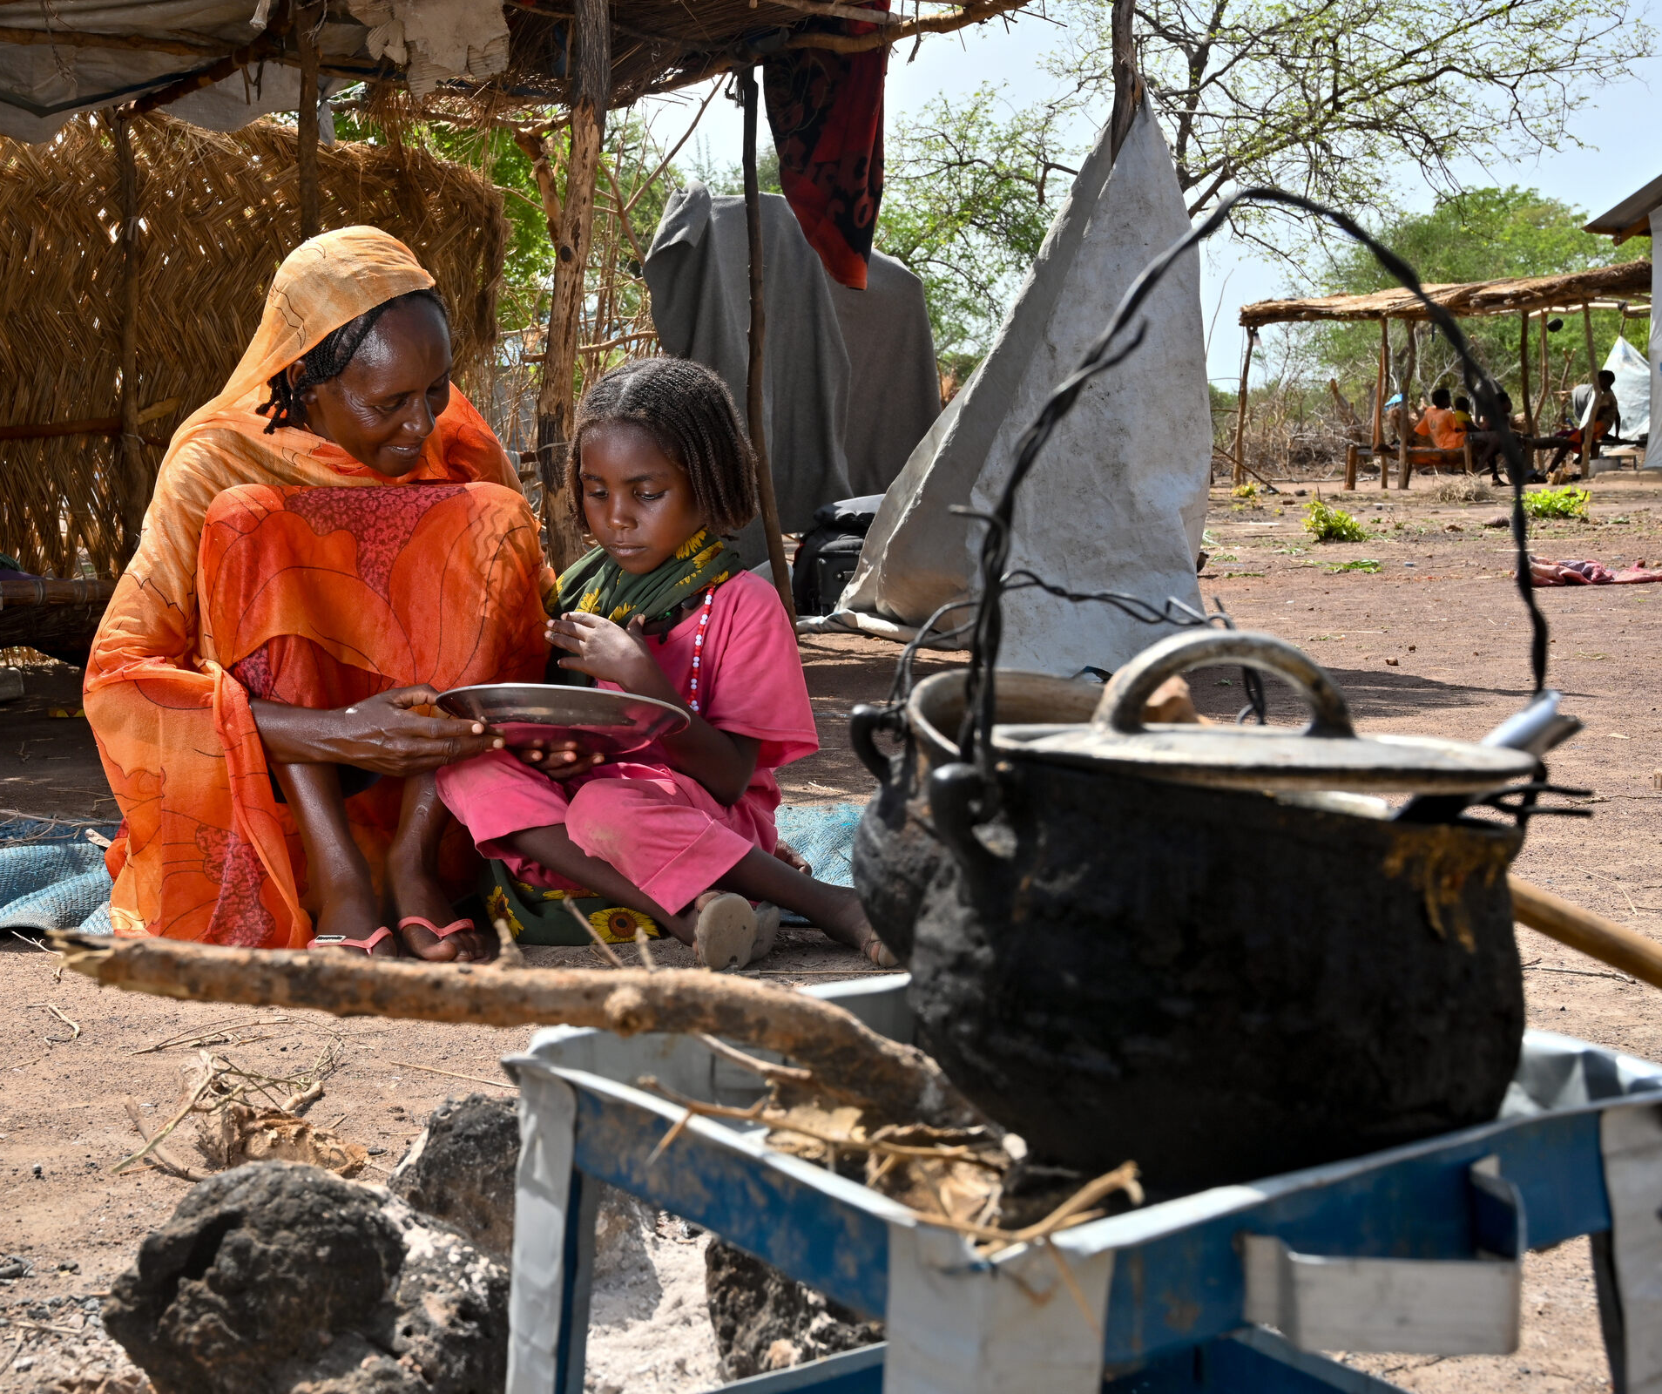
“When they give us support, we appreciate it. This money will help me so much.”
- Shede

Slide 12
Shede must now carefully balance her food and cash rations, deciding how much to spend on their immediate needs and how much to save to replace their lost belongings.
As Shede looks to the future, she wants to save up to buy cooking pots and utensils. Shede knows preparing food will be a means for her to earn a living.
If Shede can secure these items, she’ll slowly but surely builda brighter future for herself and her girls.

Slide 13
Our Response
We can give to support the work of Christian Aid’s partners in South Sudan and beyond:
£5 could purchase the shovel that means someone can establish a vital veg plot.
£8 could buy the 4kg bag of corn that means a family can prepare several filling meals.
£10 could pay for the watering can that means a family can nurture a nutritious crop.

Slide 14
Our Response
We can act as a church by:
Campaigning for climate justice
Petitioning the UK Government to push for peace in South Sudan (check out Christian Aid’s website for the petition).
Welcoming refugees into our community and living out the radical hospitality Christ embodies.
Notes:
Christmas Appeal 2024 - Campaign action - Christian Aid

Slide 15
Our Response
We can pray as a church together, for those displaced by conflict, climate and poverty:
God of peace-making, peace-building, peace-restoring.
As we remember those for whom peace is a far-off memory,
whose daily bread is conflict, uncertainty and fear,
grant that we who have safe beds and secure homes
would also have the courage not just to speak peace
but to keep peace and to build peace, wherever we are.
God of peace, strengthen our hearts to act
in service of those living through violence and conflict.
Amen
Notes:
Christmas Appeal 2024 - Campaign action - Christian Aid

